Slide 1
Education Pays 2019 THE BENEFITS OF HIGHER EDUCATION FOR INDIVIDUALS AND SOCIETY
Trends in Higher Education Series
Jennifer Ma, Matea Pender, and Meredith Welch

Slide 2
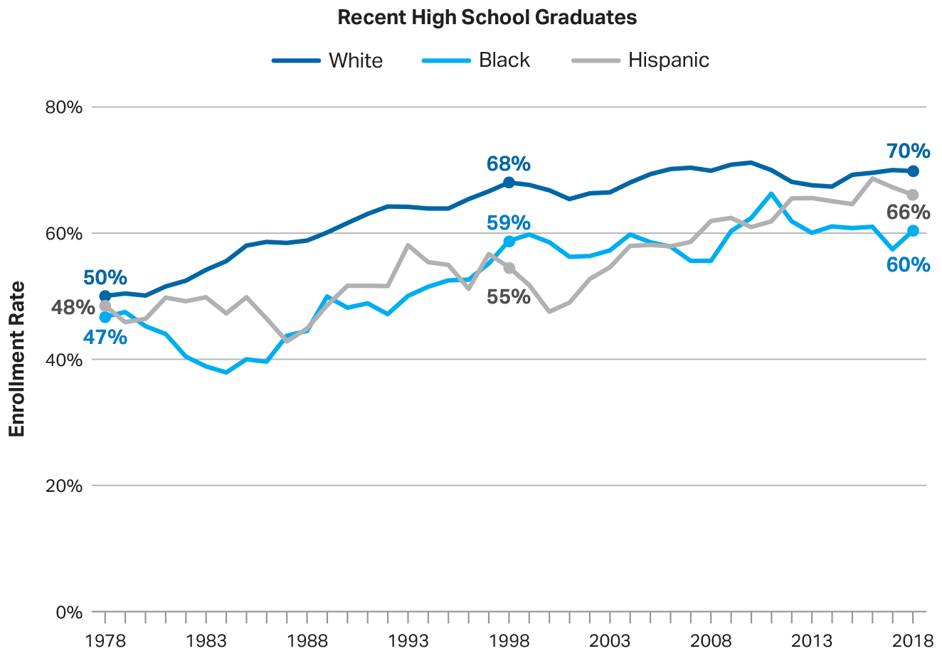
Postsecondary Enrollment Rates of Recent High School Graduates by Race/Ethnicity, 1978 to 2018
SOURCE: The College Board, Education Pays 2019, Figure 1.1A

Slide 3
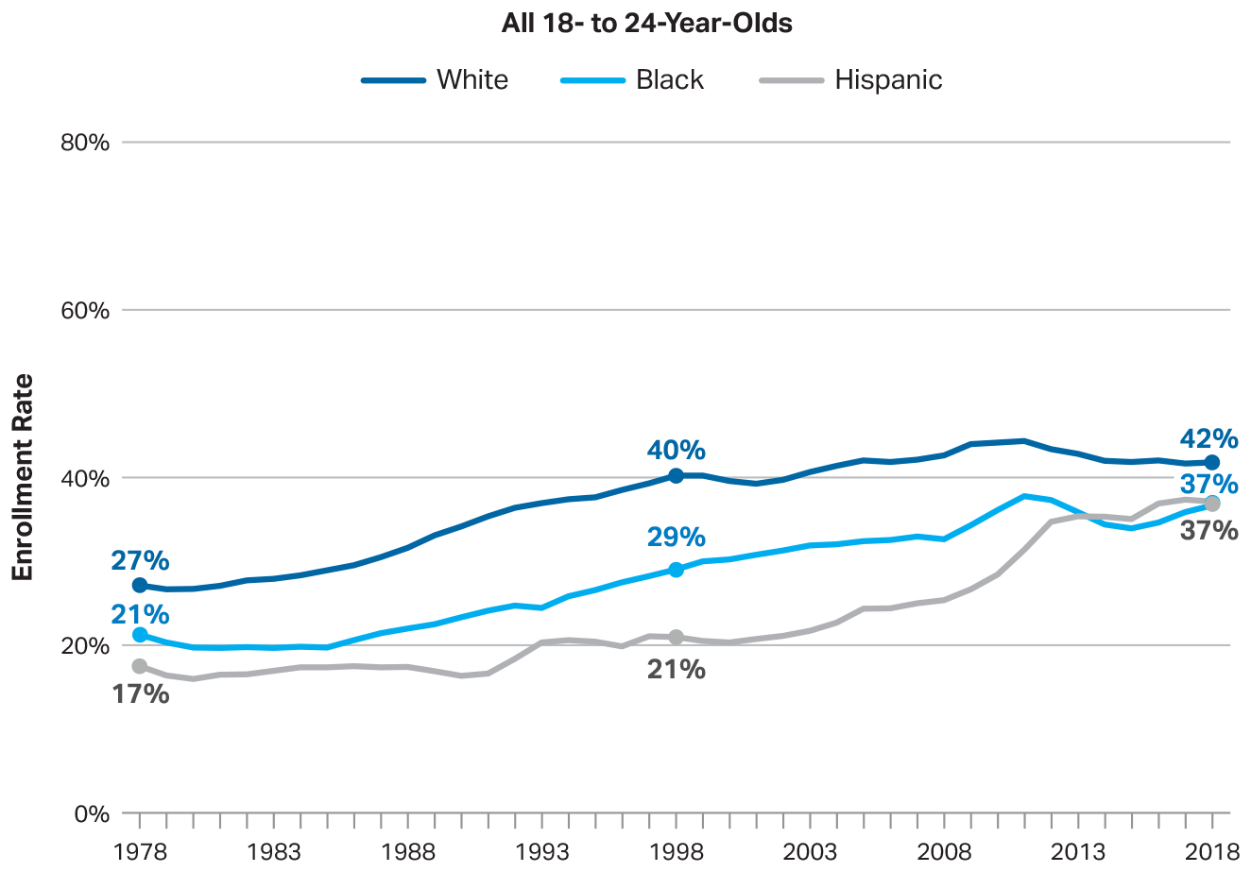
Postsecondary Enrollment Rates of All 18- to 24-Year-Olds by Race/Ethnicity, 1978 to 2018
SOURCE: The College Board, Education Pays 2019, Figure 1.1B

Slide 4
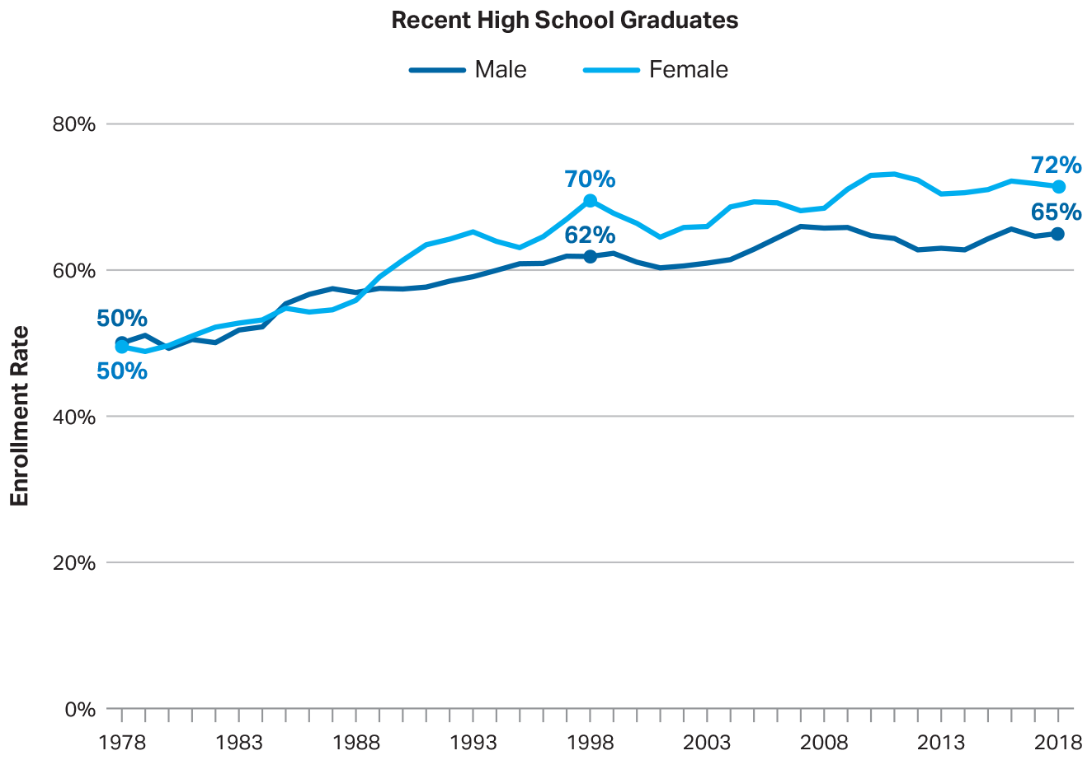
Postsecondary Enrollment Rates of Recent High School Graduates by Gender, 1978 to 2018
SOURCE: The College Board, Education Pays 2019, Figure 1.2A

Slide 5
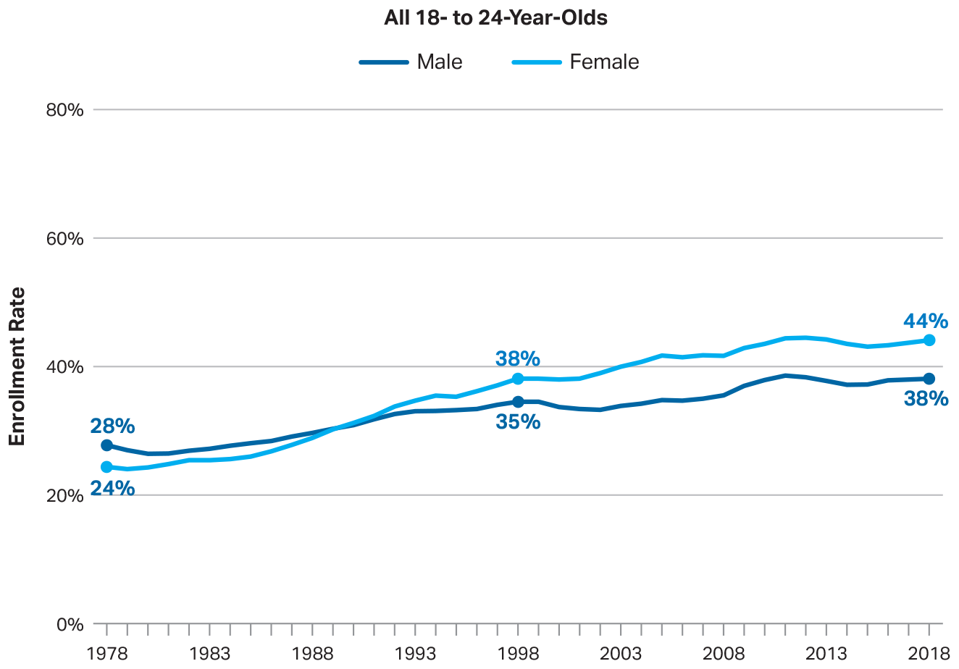
Postsecondary Enrollment Rates of All 18- to 24-Year-Olds by Gender, 1978 to 2018
SOURCE: The College Board, Education Pays 2019, Figure 1.2B

Slide 6
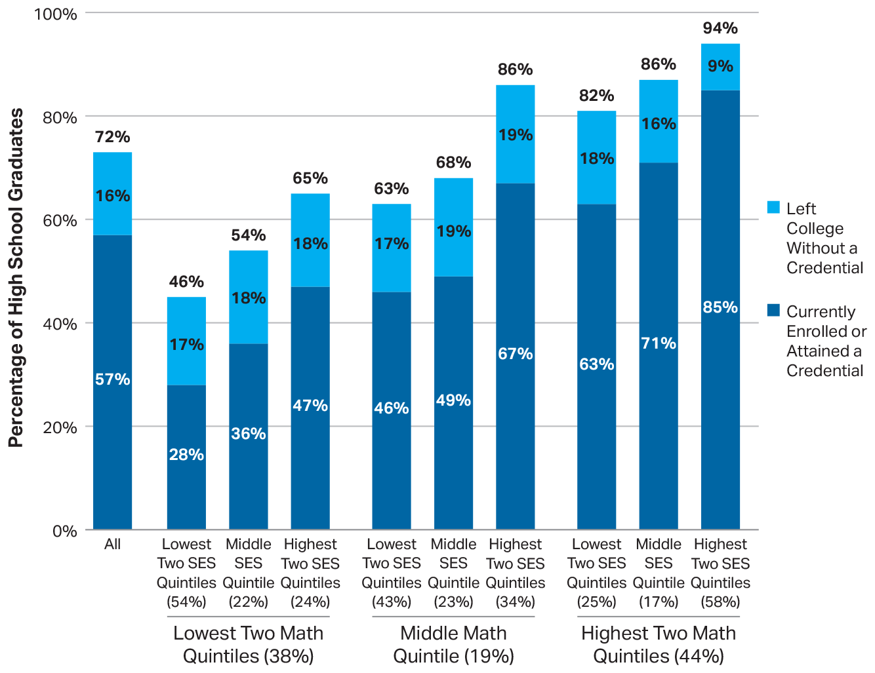
Postsecondary Enrollment Status in 2016 by Math Quintile and Parents’ Socioeconomic Status: High School Class of 2013
SOURCE: The College Board, Education Pays 2019, Figure 1.3A

Slide 7
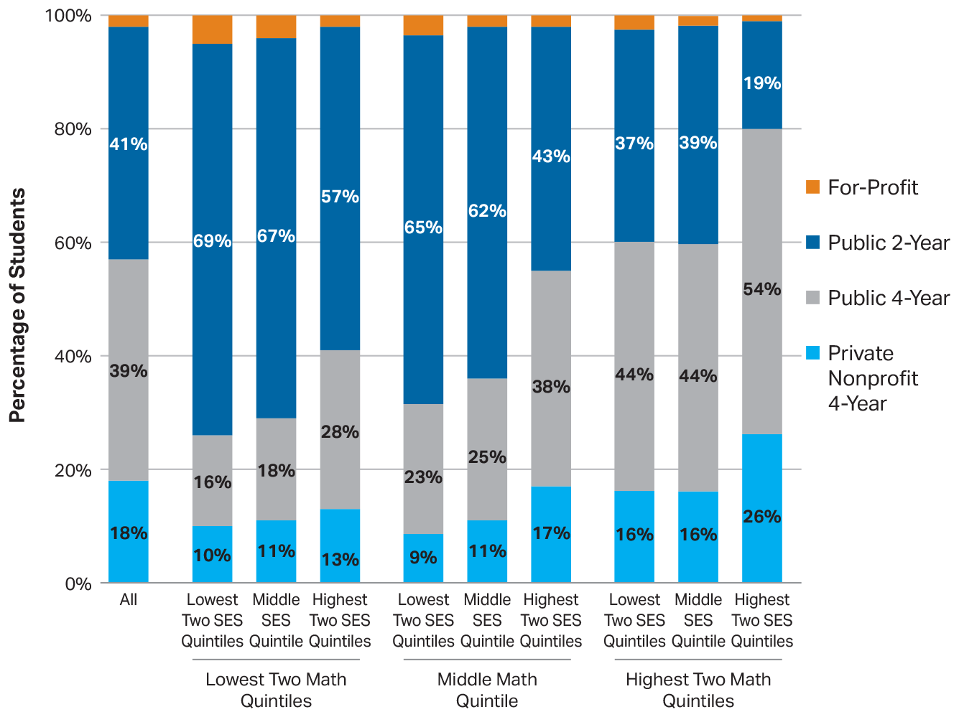
Sector of First Postsecondary Institution by Math Quintile and Parents’ Socioeconomic Status: High School Class of 2013
SOURCE: The College Board, Education Pays 2019, Figure 1.3B

Slide 8
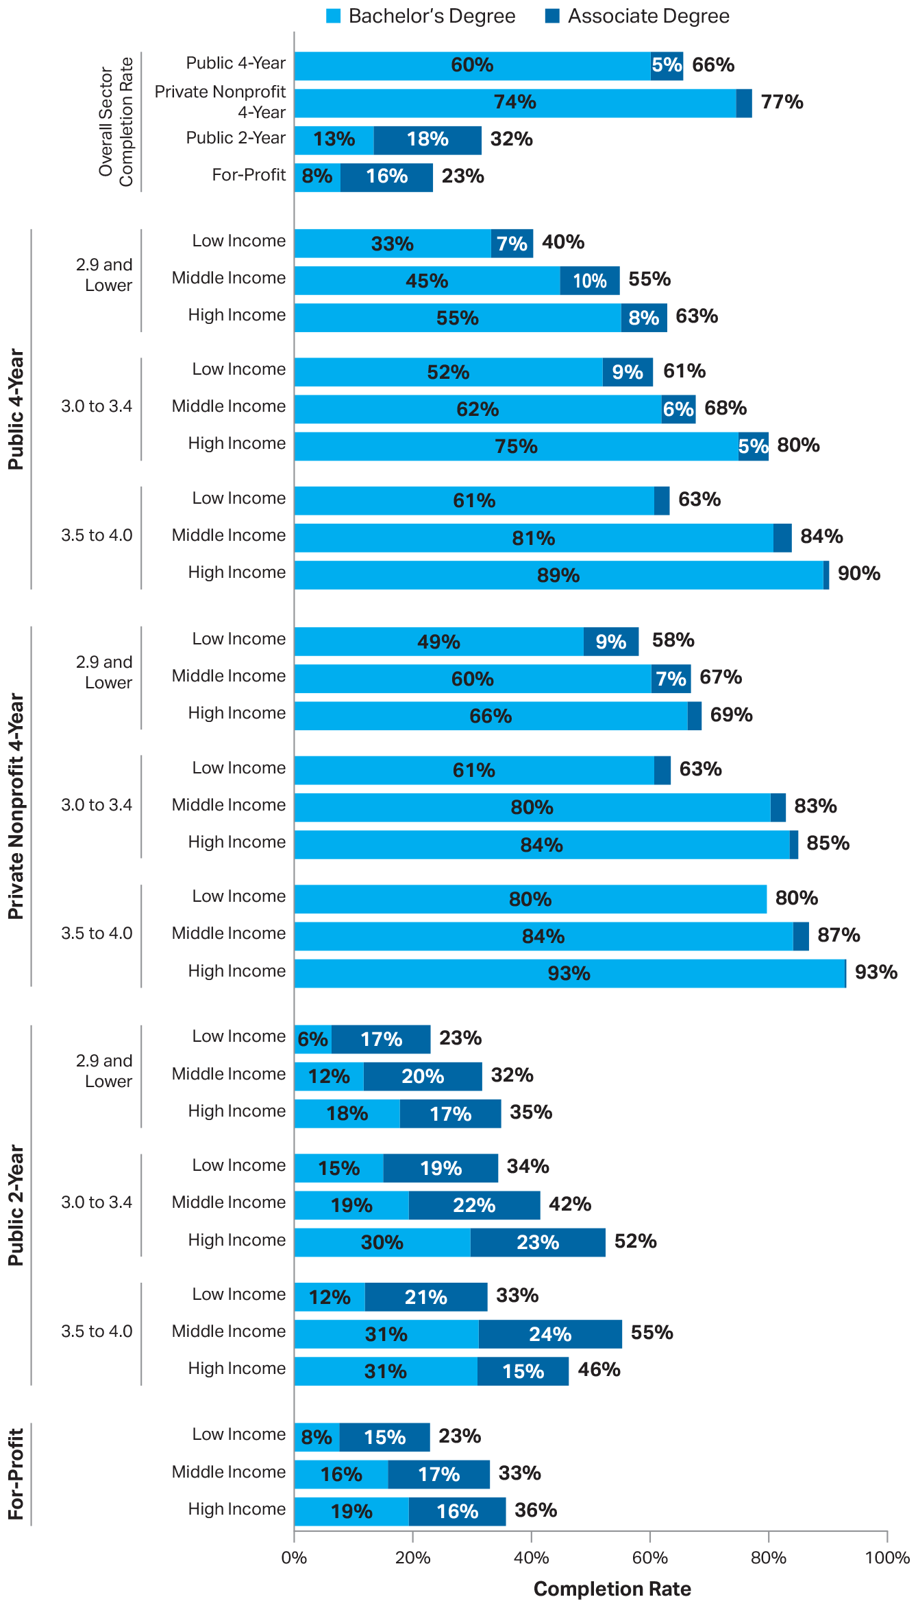
Six-Year Completion Rates by Sector, High School GPA, and Family Income: 2011-12 Beginning Postsecondary Students
SOURCE: The College Board, Education Pays 2019, Figure 1.4

Slide 9
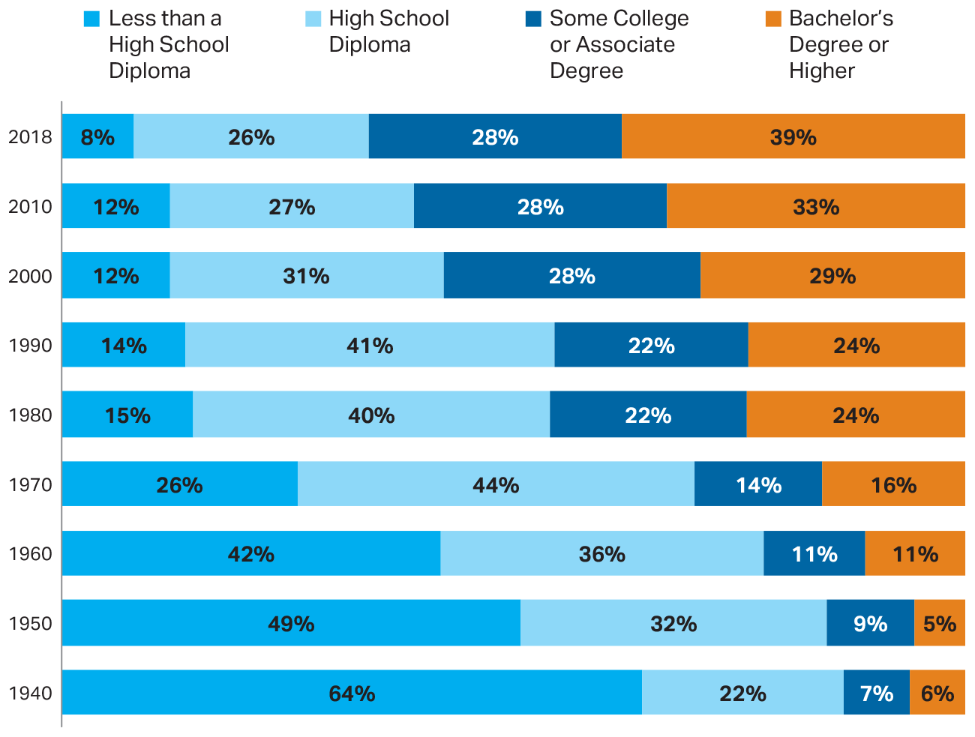
Educational Attainment of Individuals Age 25 to 34, 1940 to 2018
SOURCE: The College Board, Education Pays 2019, Figure 1.5A

Slide 10
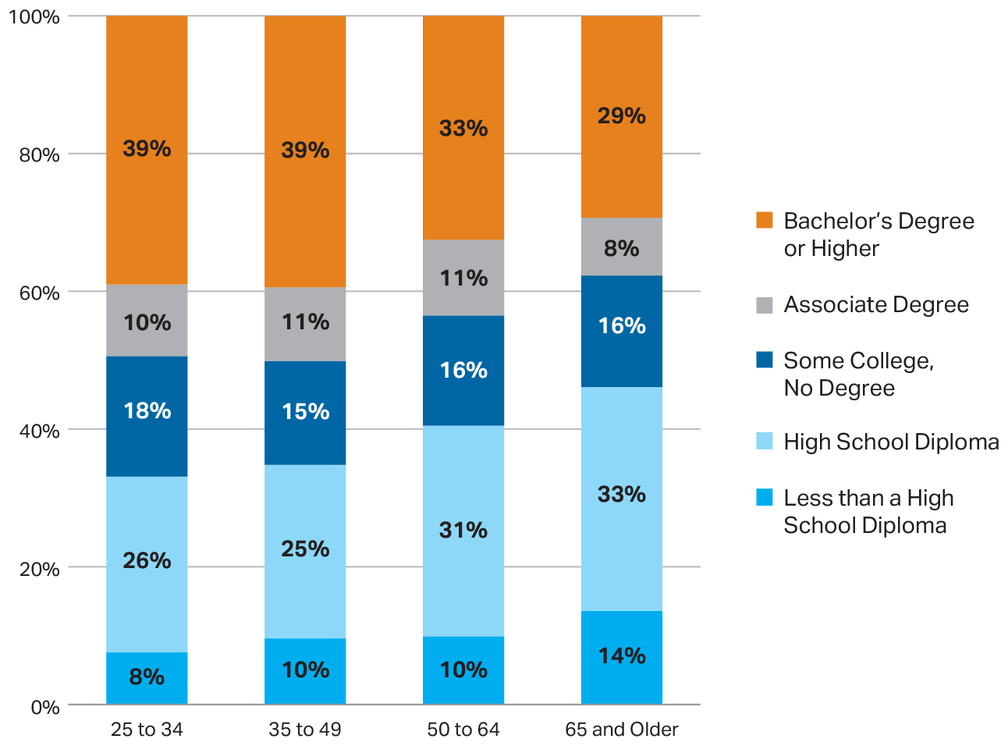
Educational Attainment of Individuals by Age Group, 2018
SOURCE: The College Board, Education Pays 2019, Figure 1.5B

Slide 11
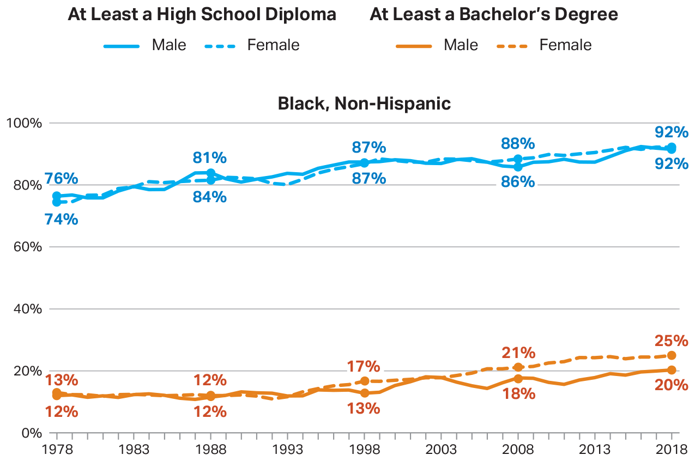
Percentage of 25- to 29-Year-Olds Who Have Completed High School or a Bachelor’s Degree, 1978 to 2018
SOURCE: The College Board, Education Pays 2019, Figure 1.6

Slide 12
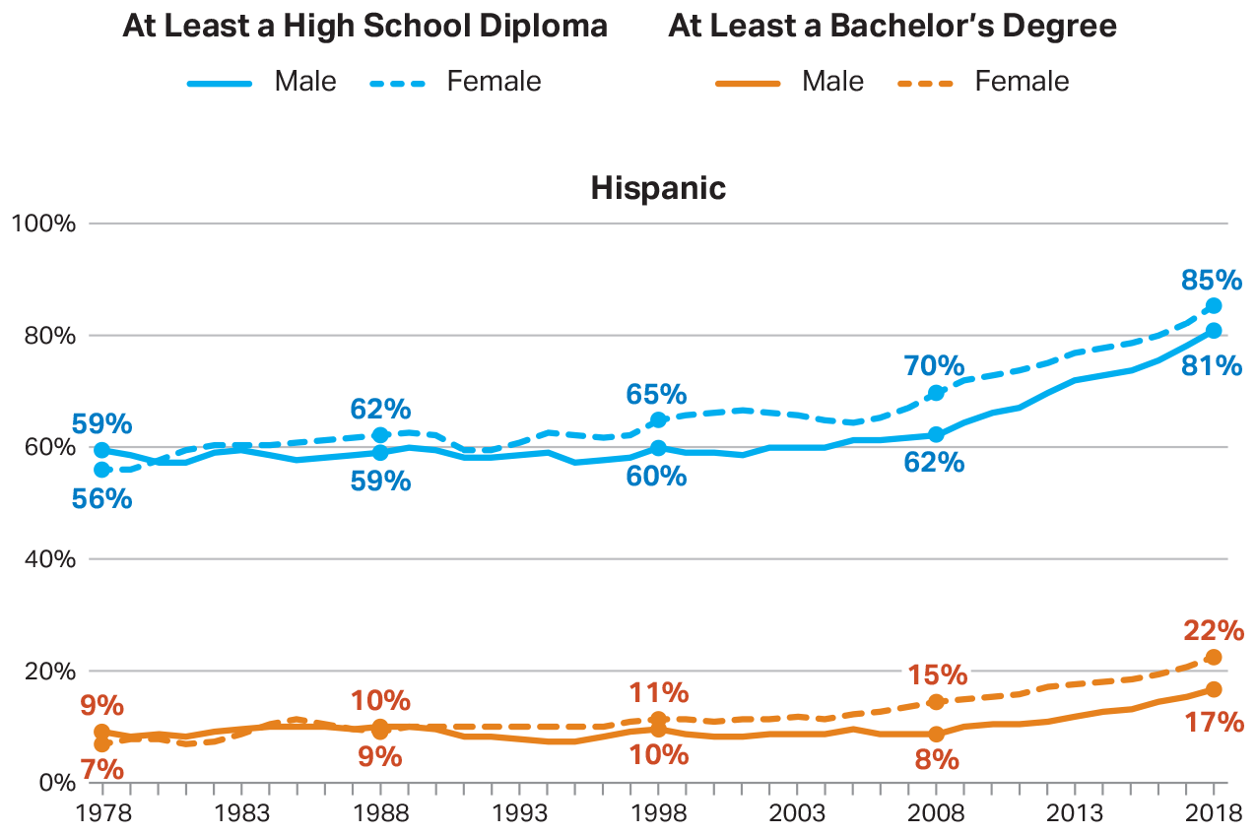
Percentage of 25- to 29-Year-Olds Who Have Completed High School or a Bachelor’s Degree, 1978 to 2018
SOURCE: The College Board, Education Pays 2019, Figure 1.6

Slide 13
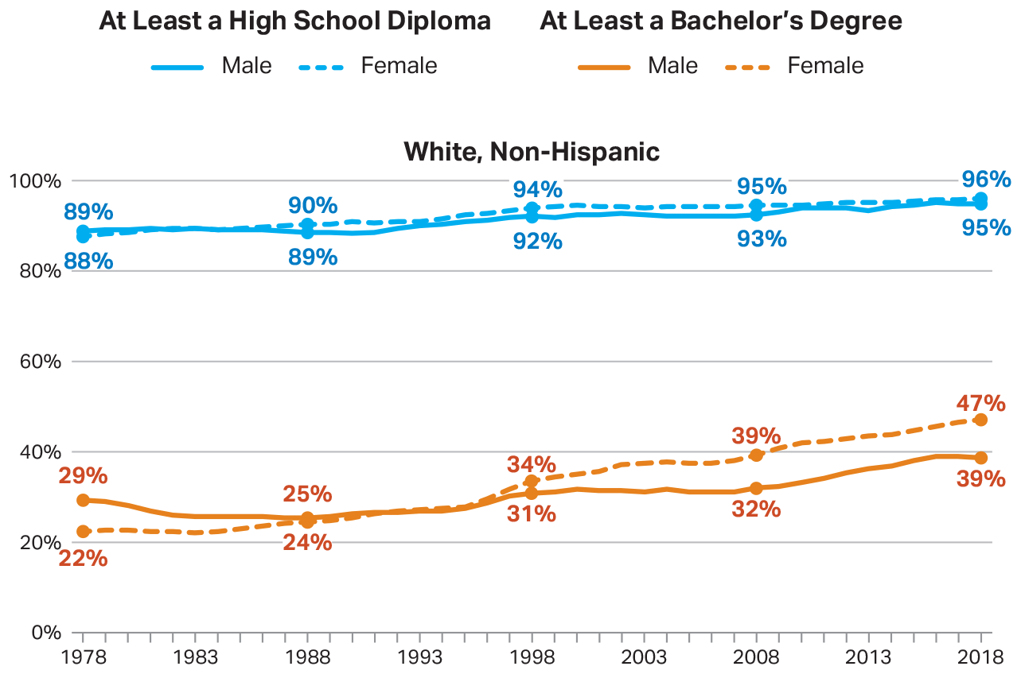
Percentage of 25- to 29-Year-Olds Who Have Completed High School or a Bachelor’s Degree, 1978 to 2018
SOURCE: The College Board, Education Pays 2019, Figure 1.6

Slide 14
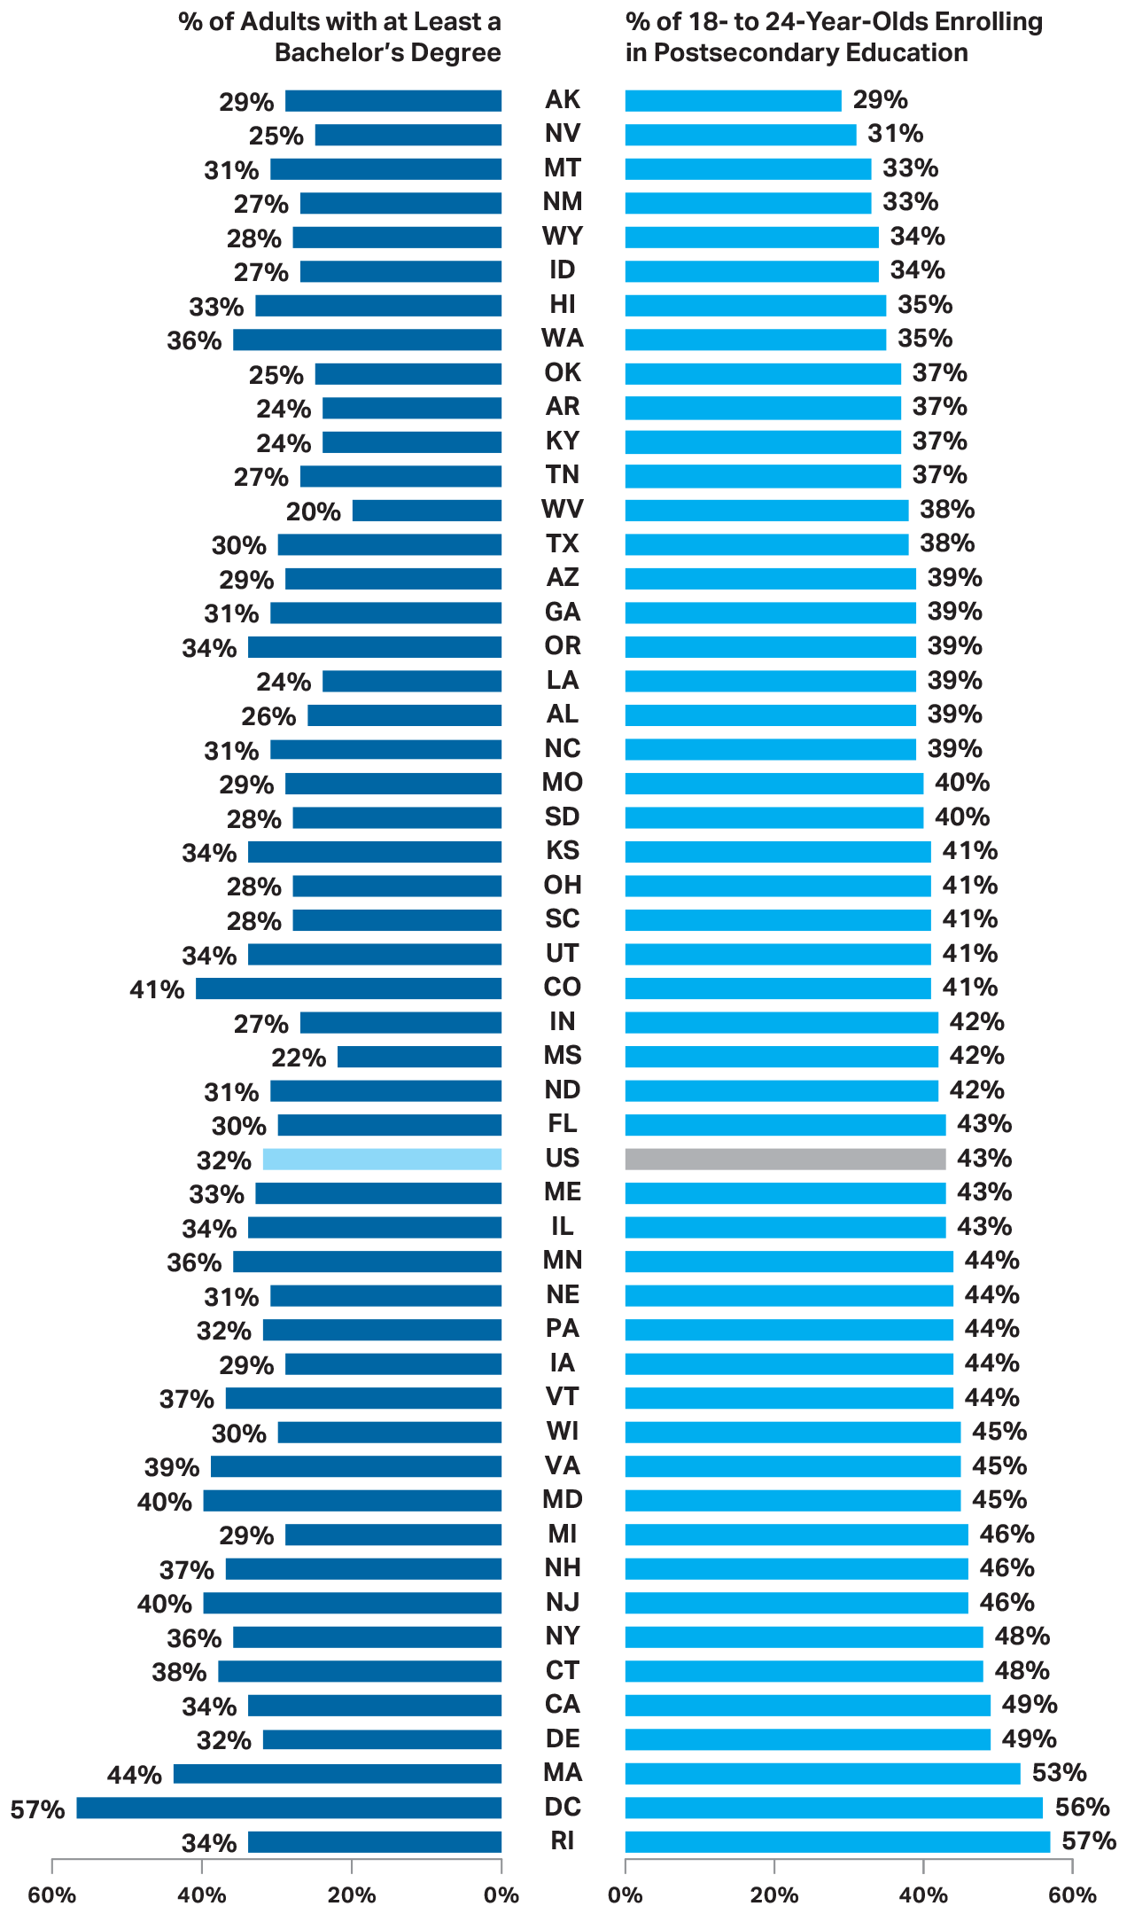
Postsecondary Enrollment Rates of 18- to 24-Year-Olds and Percentage of All Adults with at Least a Bachelor’s Degree in 2017
SOURCE: The College Board, Education Pays 2019, Figure 1.7

Slide 15
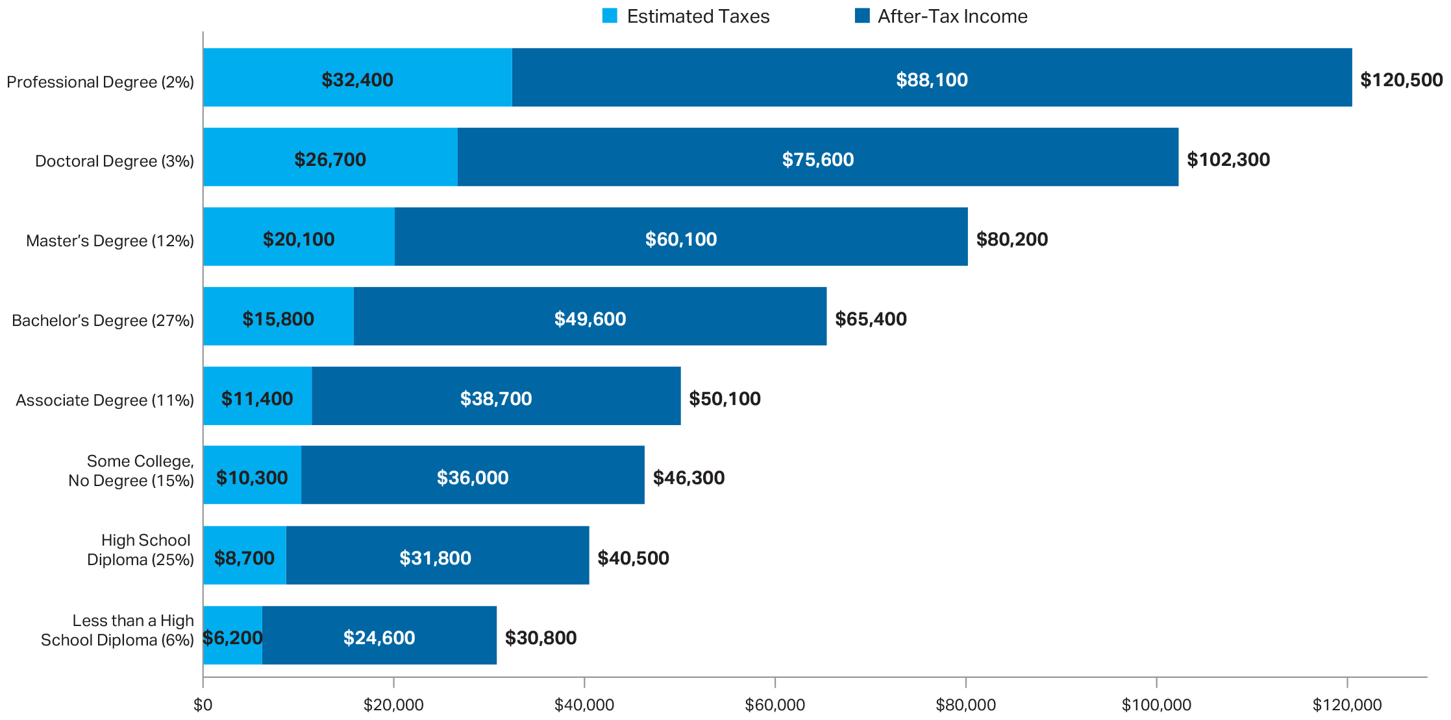
Median Earnings and Tax Payments of Full-Time Year-Round Workers Age 25 and Older, by Education Level, 2018
SOURCE: The College Board, Education Pays 2019, Figure 2.1

Slide 16
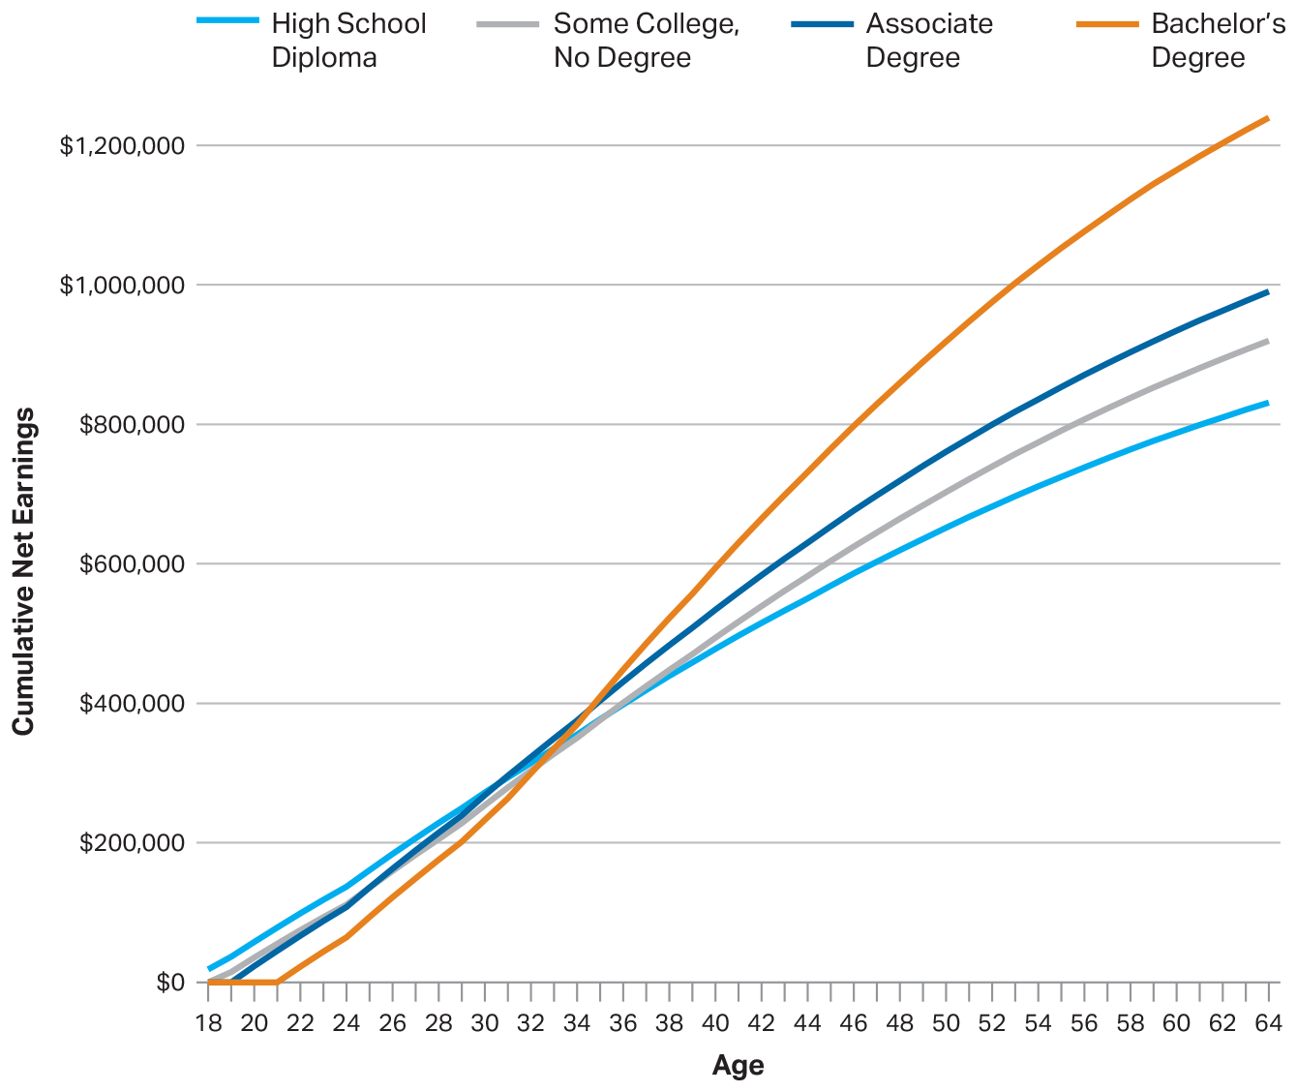
Estimated Cumulative Full-Time Earnings (in 2017 Dollars) Net of Forgone Earnings and Payment for Tuition and Fees and Books and Supplies, by Education Level
SOURCE: The College Board, Education Pays 2019, Figure 2.2A

Slide 17
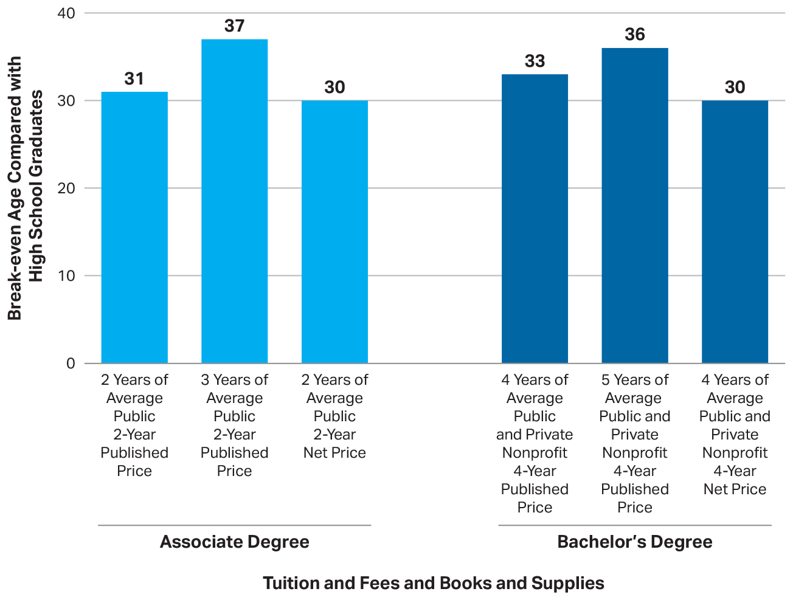
Age at Which Cumulative Earnings of College Graduates Exceed Those of High School Graduates, by Degree and College Cost
SOURCE: The College Board, Education Pays 2019, Figure 2.2B

Slide 18
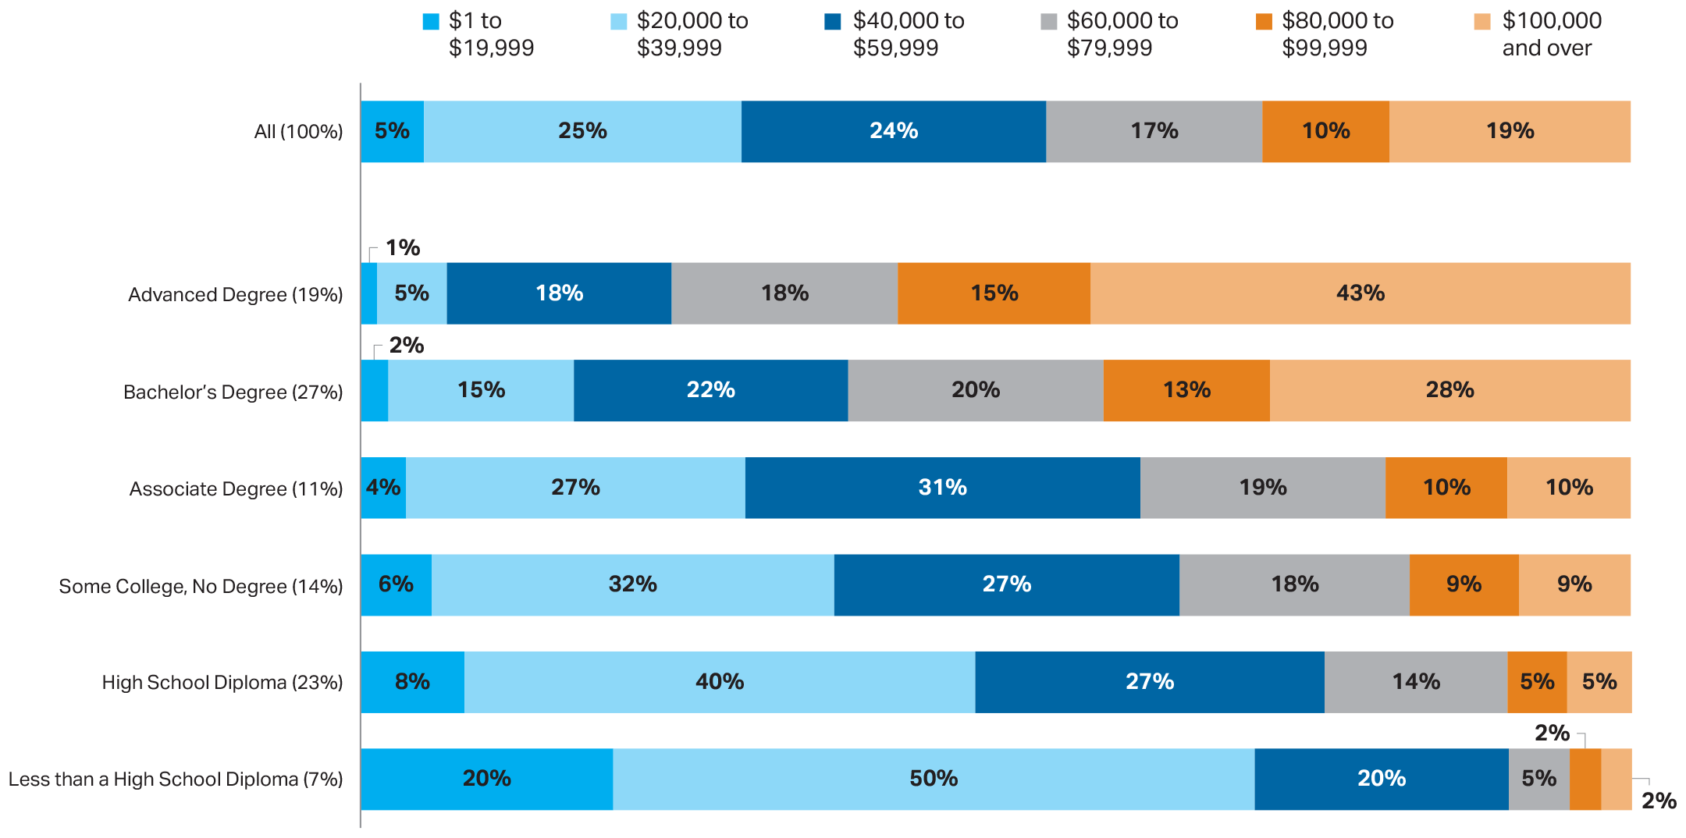
Earnings Distribution of Full-Time Year-Round Workers Age 35 to 44, by Education Level, 2018
SOURCE: The College Board, Education Pays 2019, Figure 2.3

Slide 19
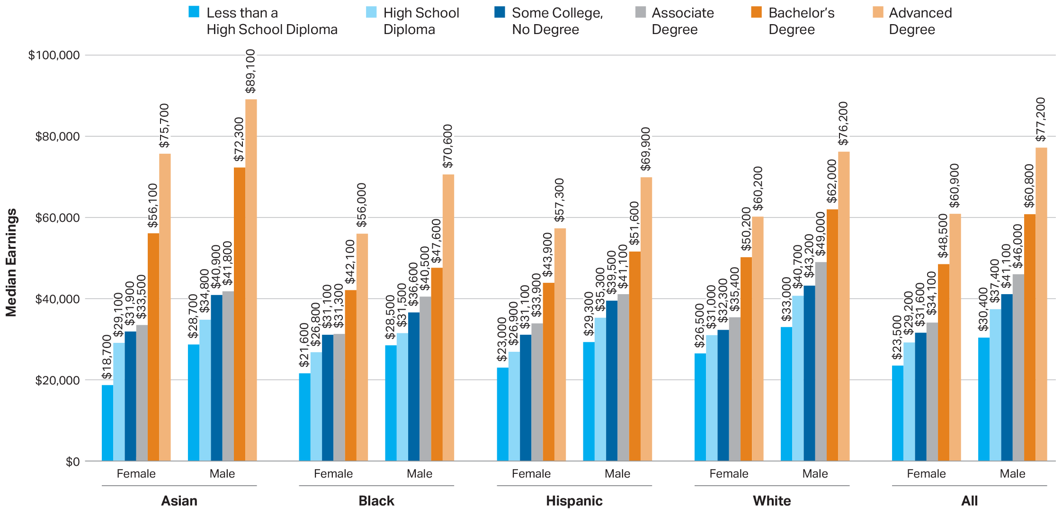
Median Earnings (in 2018 Dollars) of Full-Time Year-Round Workers Age 25 to 34, by Race/Ethnicity, Gender, and Education Level, 2016–2018
SOURCE: The College Board, Education Pays 2019, Figure 2.4

Slide 20
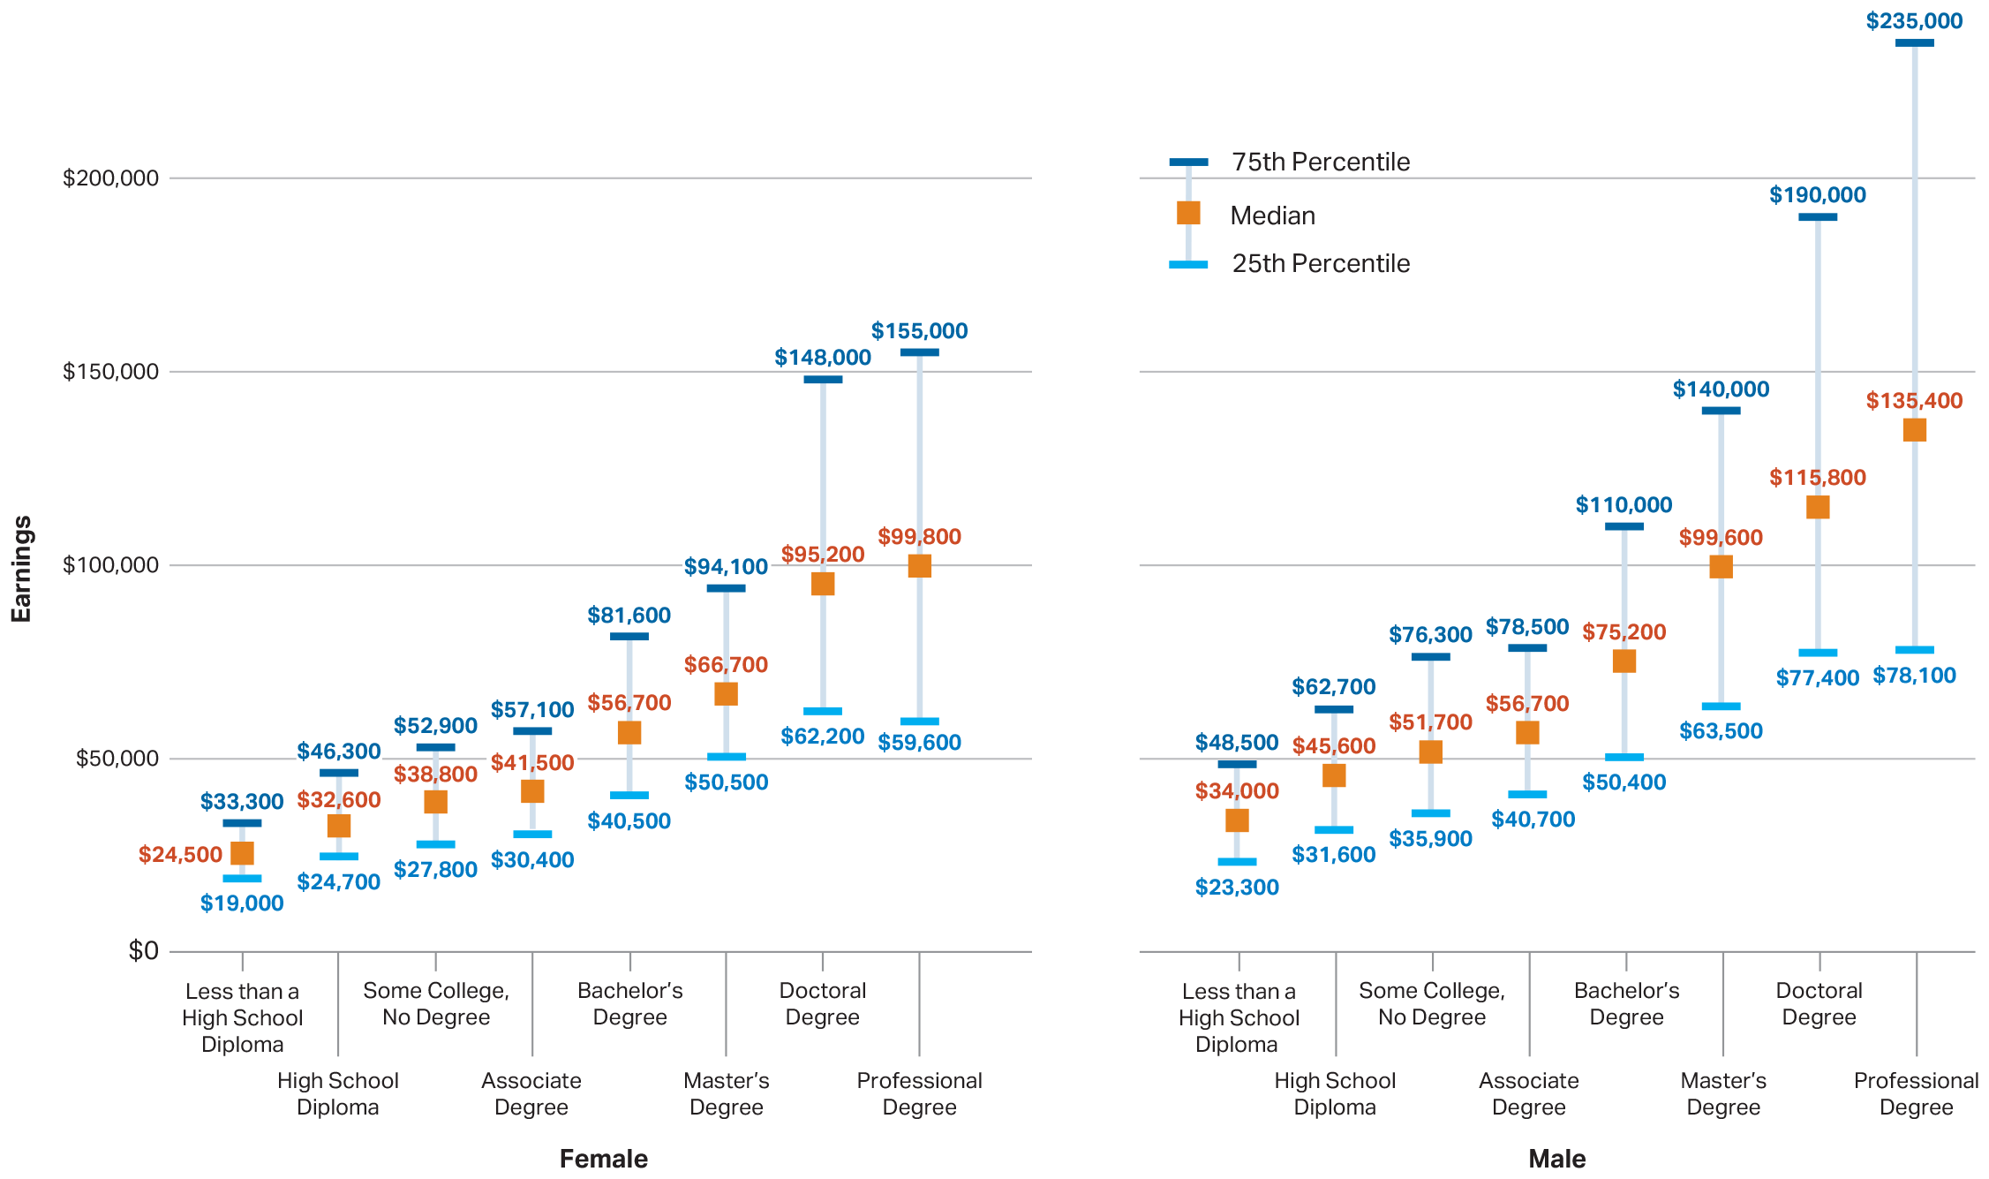
Median, 25th Percentile, and 75th Percentile of Earnings of Full-Time Year-Round Workers Age 25 and Older, by Gender and Education Level, 2018
SOURCE: The College Board, Education Pays 2019, Figure 2.5

Slide 21
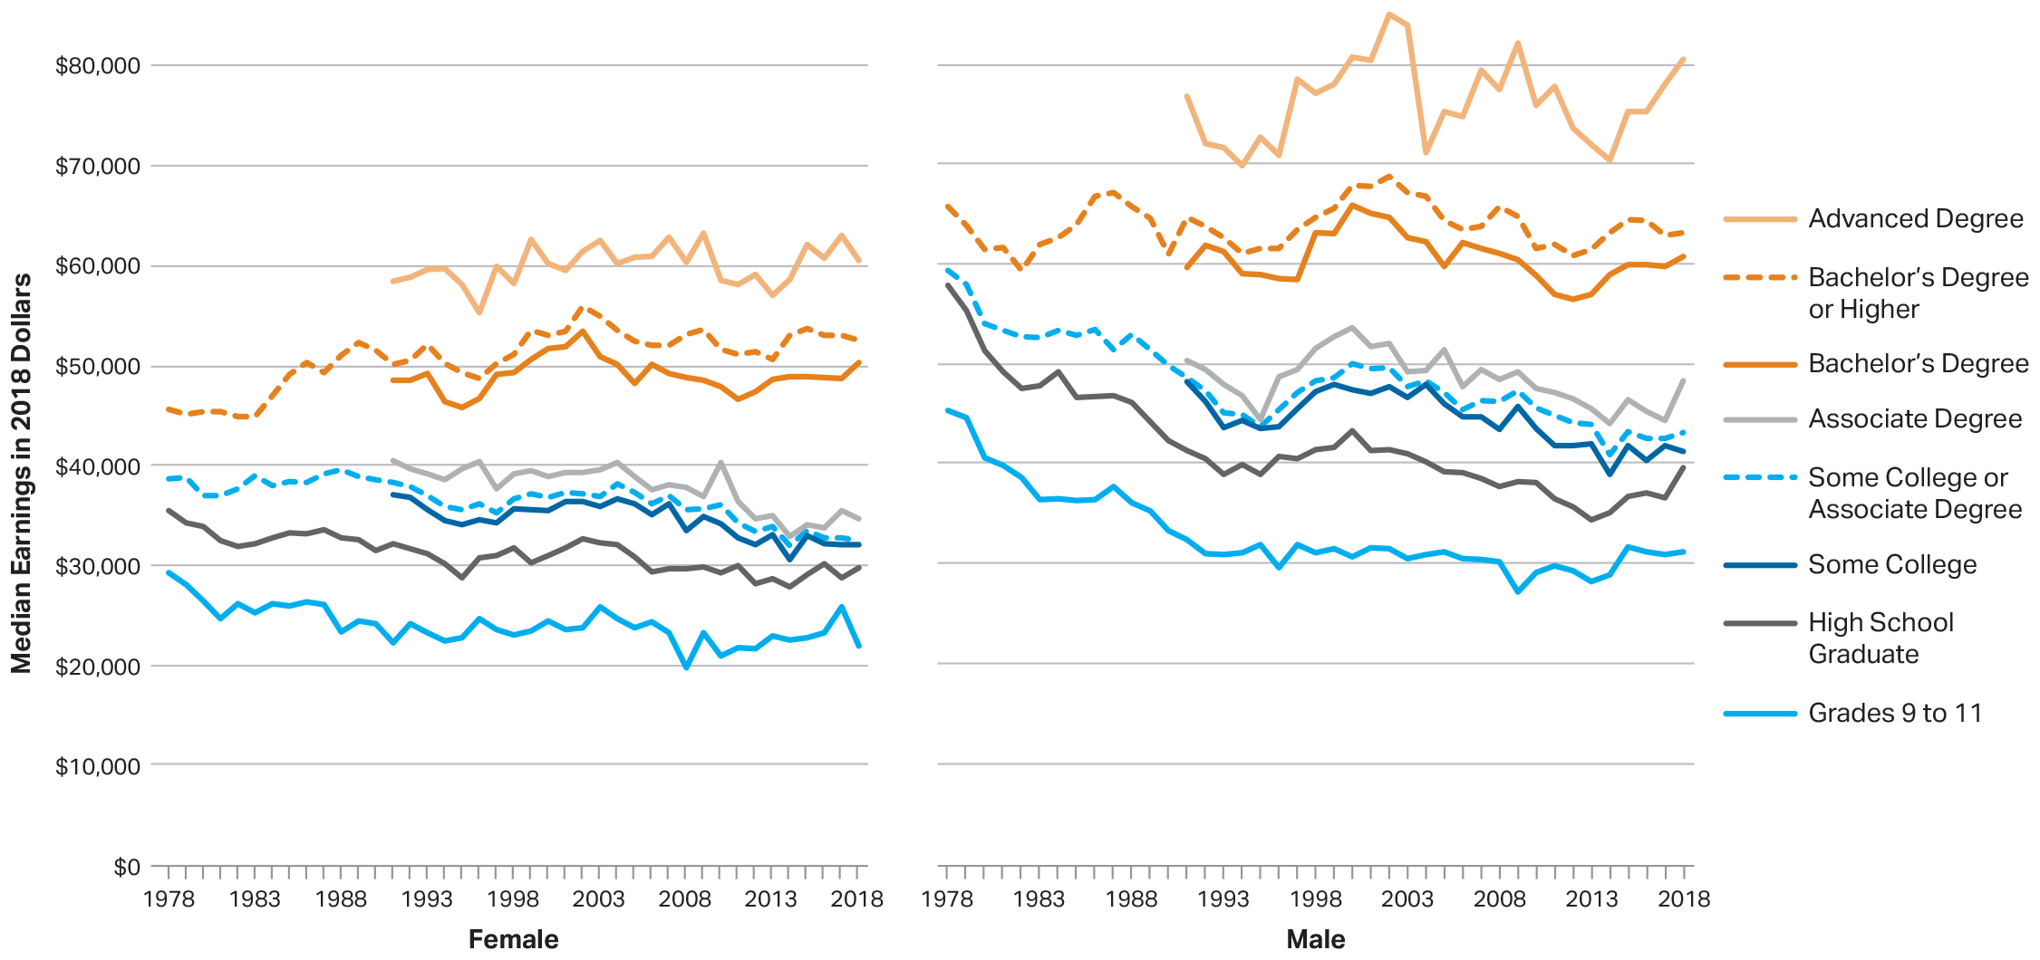
Median Earnings (in 2018 Dollars) of Full-Time Year-Round Workers Age 25 to 34, by Gender and Education Level, 1978 to 2018
SOURCE: The College Board, Education Pays 2019, Figure 2.6

Slide 22
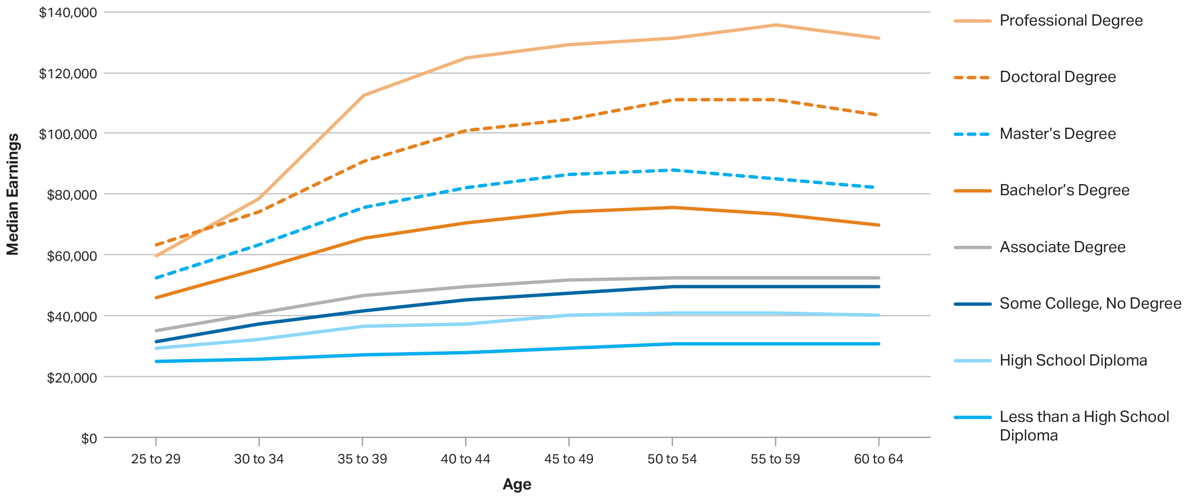
Median Earnings (in 2017 Dollars) of Full-Time Year-Round Workers by Age and Education Level, 2013–2017
SOURCE: The College Board, Education Pays 2019, Figure 2.7

Slide 23
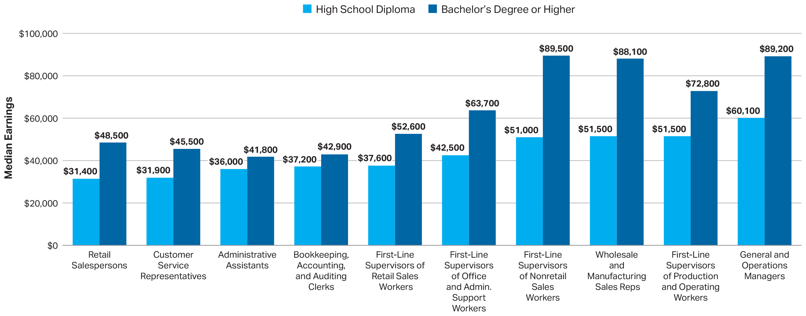
Median Earnings (in 2017 Dollars) of Full-Time Workers Age 25 and Older with a High School Diploma and Those with at Least a Bachelor’s Degree, by Occupation, 2013–2017
SOURCE: The College Board, Education Pays 2019, Figure 2.8

Slide 24
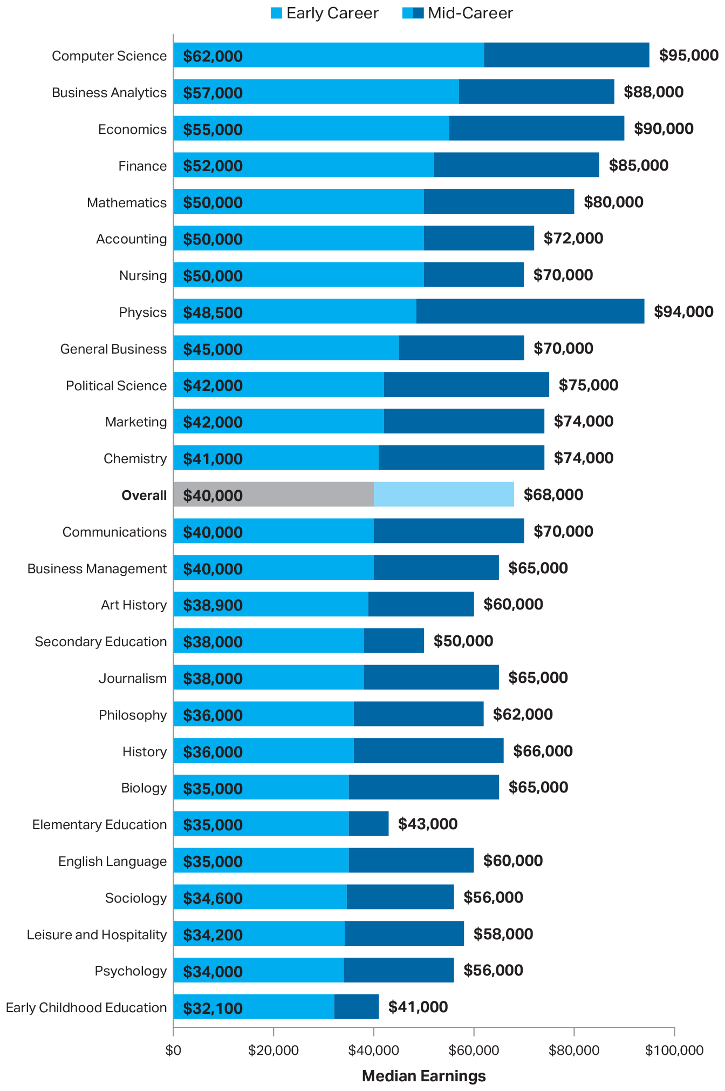
Median Earnings of Early Career and Mid-Career College Graduates Working Full Time, by College Major, 2016–2017
SOURCE: The College Board, Education Pays 2019, Figure 2.9

Slide 25
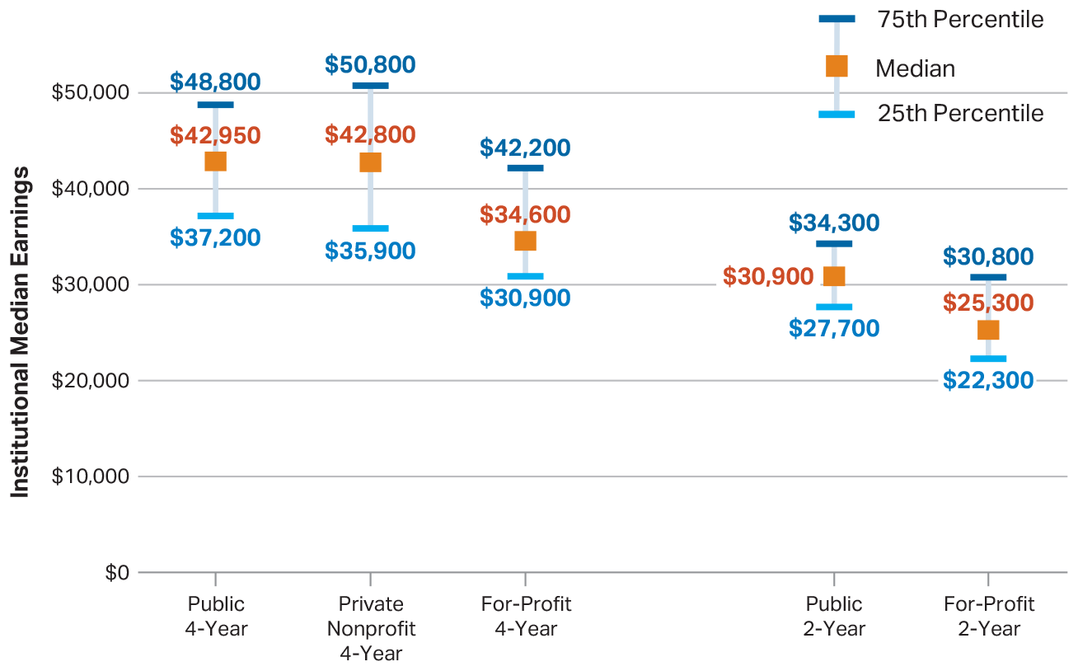
Distribution of 2014 and 2015 Institutional Median Earnings of Federal Student Aid Recipients in 2003-04 and 2004-05, by Sector
SOURCE: The College Board, Education Pays 2019, Figure 2.10A

Slide 26
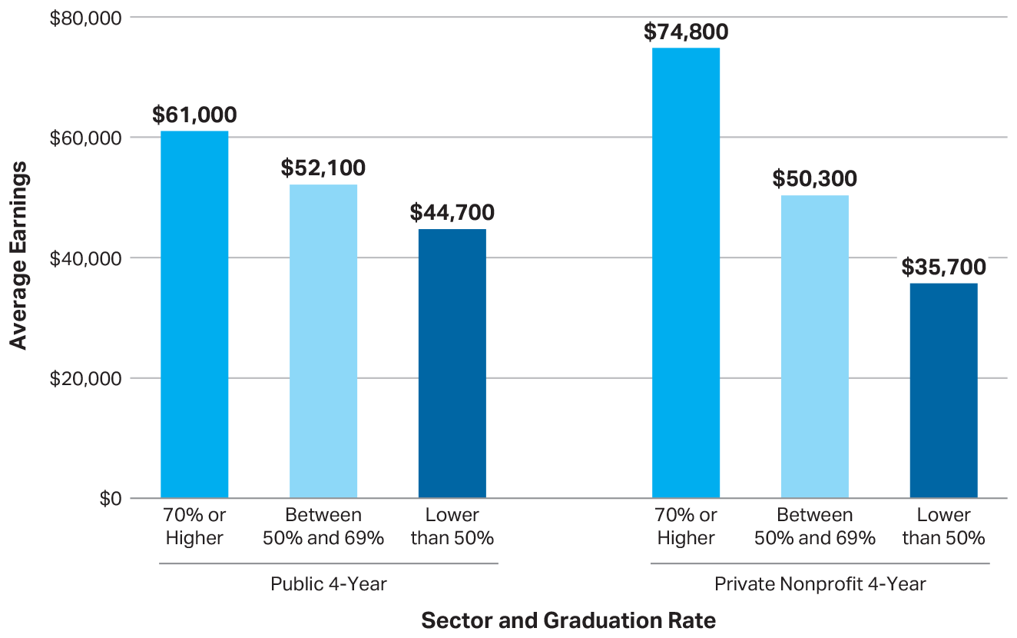
Average 2014 and 2015 Earnings of Dependent Federal Student Aid Recipients in 2003-04 and 2004-05, by Sector and Graduation Rate
SOURCE: The College Board, Education Pays 2019, Figure 2.10B

Slide 27
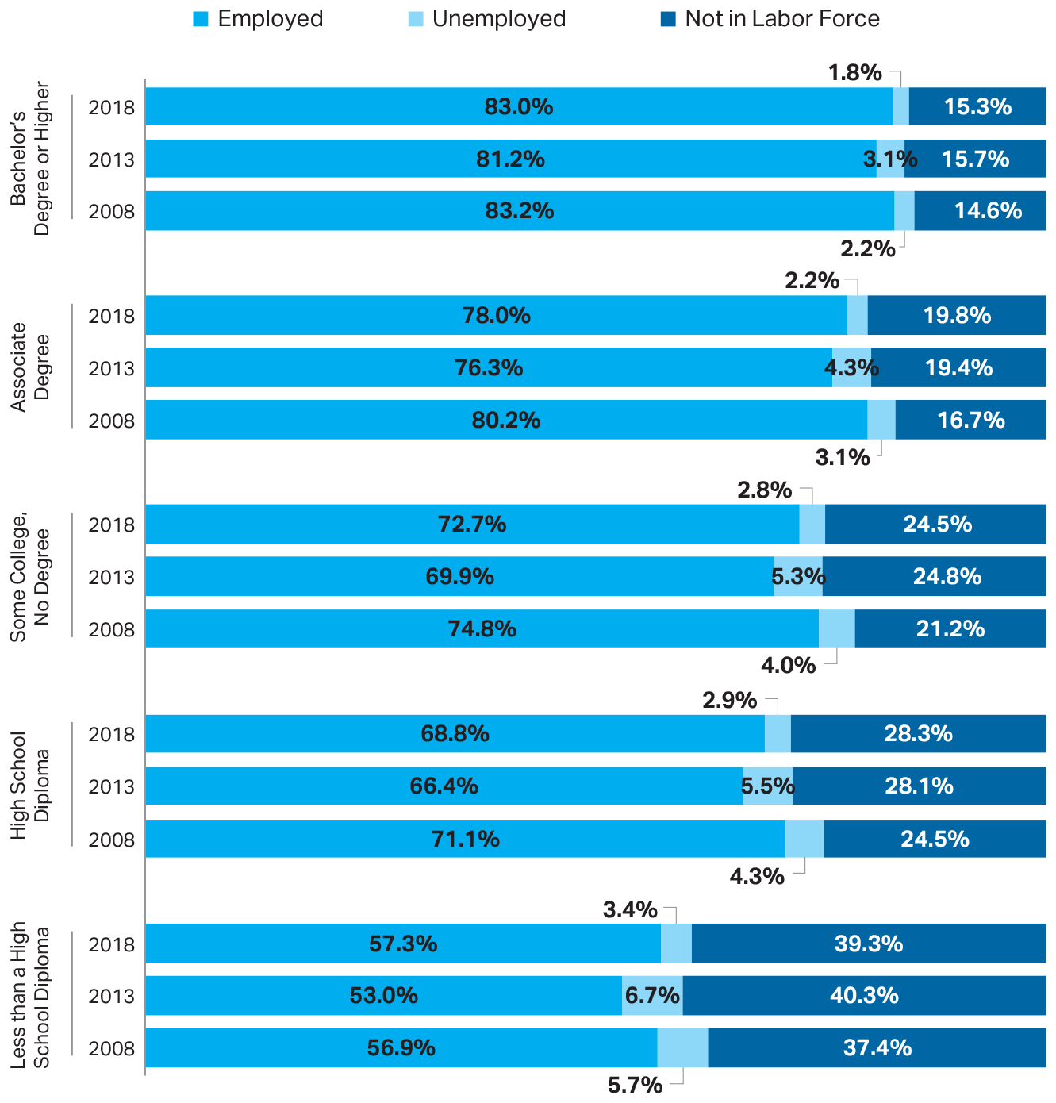
Civilian Population Age 25 to 64: Percentage Employed, Unemployed, and Not in Labor Force, 2008, 2013, and 2018
SOURCE: The College Board, Education Pays 2019, Figure 2.11

Slide 28
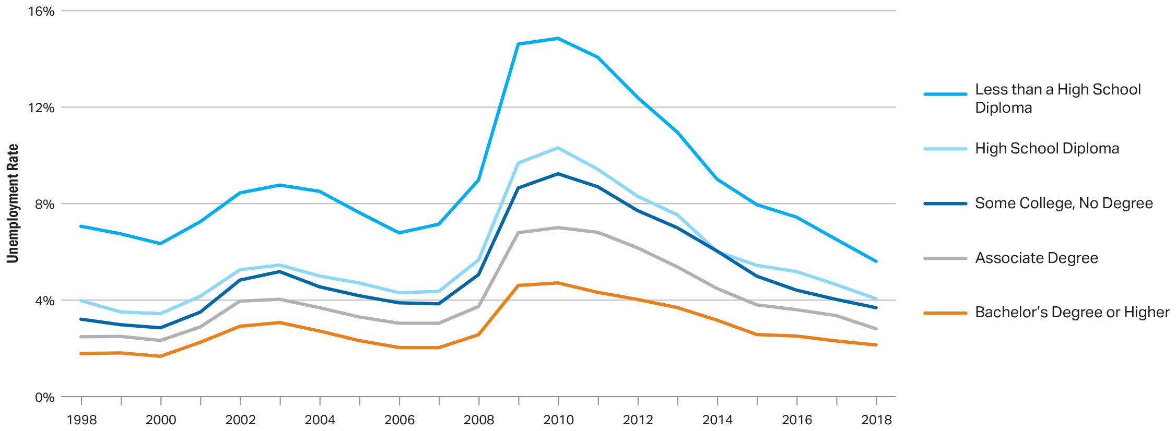
Unemployment Rates of Individuals Age 25 and Older, by Education Level, 1998 to 2018
SOURCE: The College Board, Education Pays 2019, Figure 2.12A

Slide 29
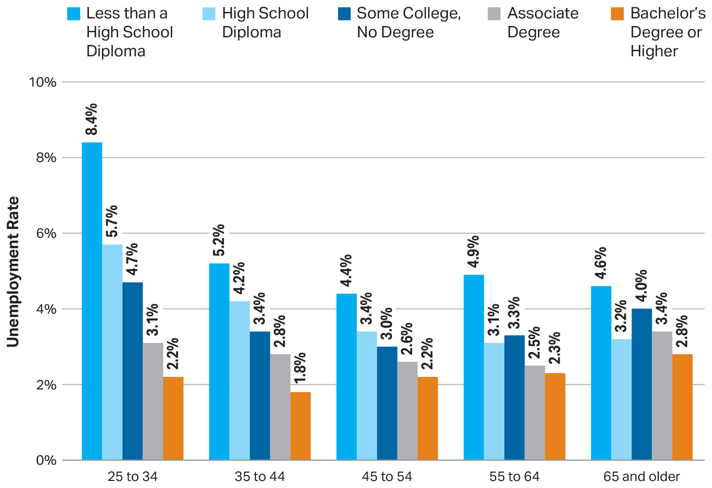
Unemployment Rates of Individuals Age 25 and Older, by Age and Education Level, 2018
SOURCE: The College Board, Education Pays 2019, Figure 2.12B

Slide 30
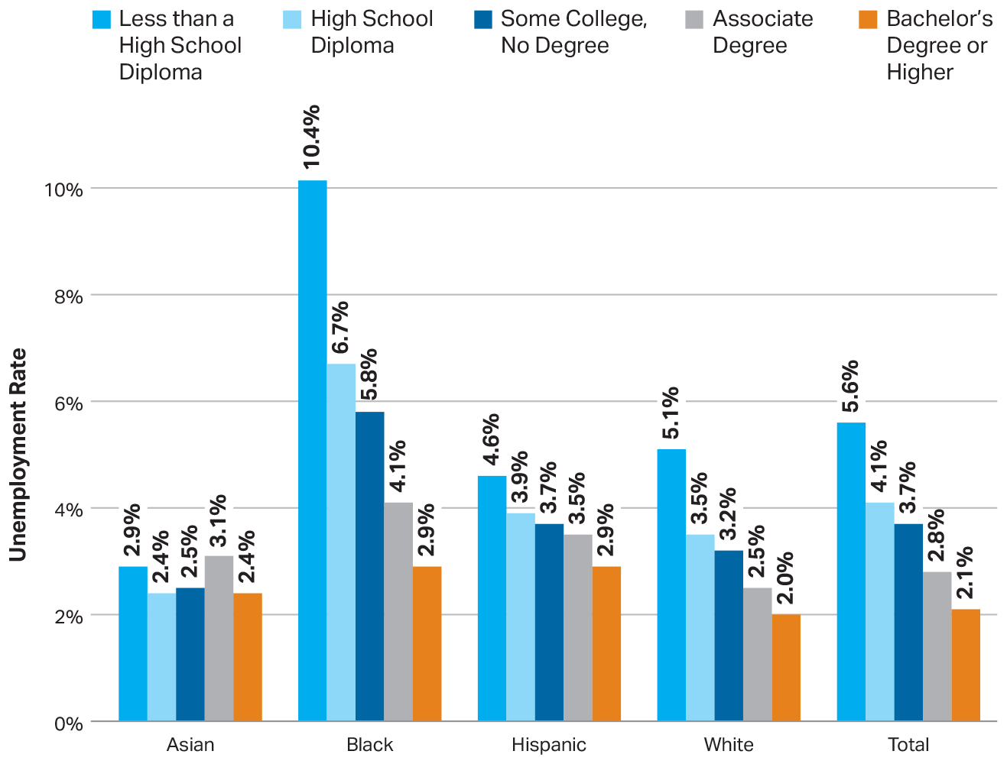
Unemployment Rates of Individuals Age 25 and Older, by Race/Ethnicity and Education Level, 2018
SOURCE: The College Board, Education Pays 2019, Figure 2.12C

Slide 31
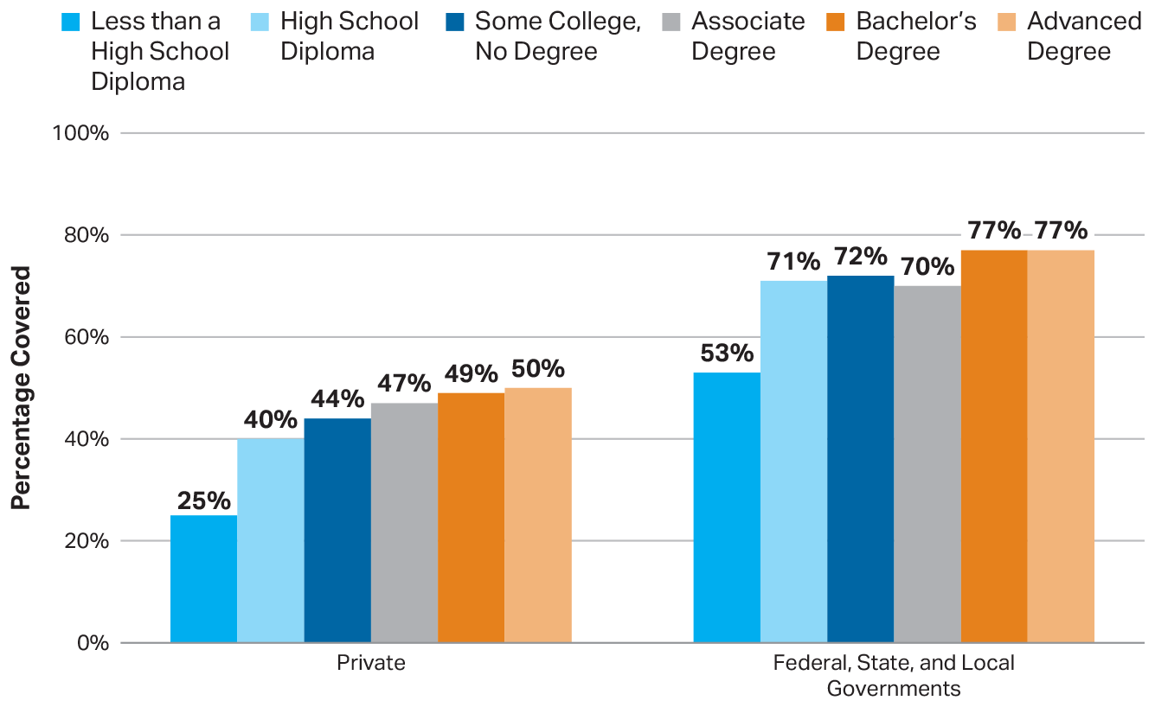
Employer-Provided Retirement Plan Coverage Among Full-Time Year-Round Workers Age 25 and Older, by Sector and Education Level, 2018
SOURCE: The College Board, Education Pays 2019, Figure 2.13

Slide 32
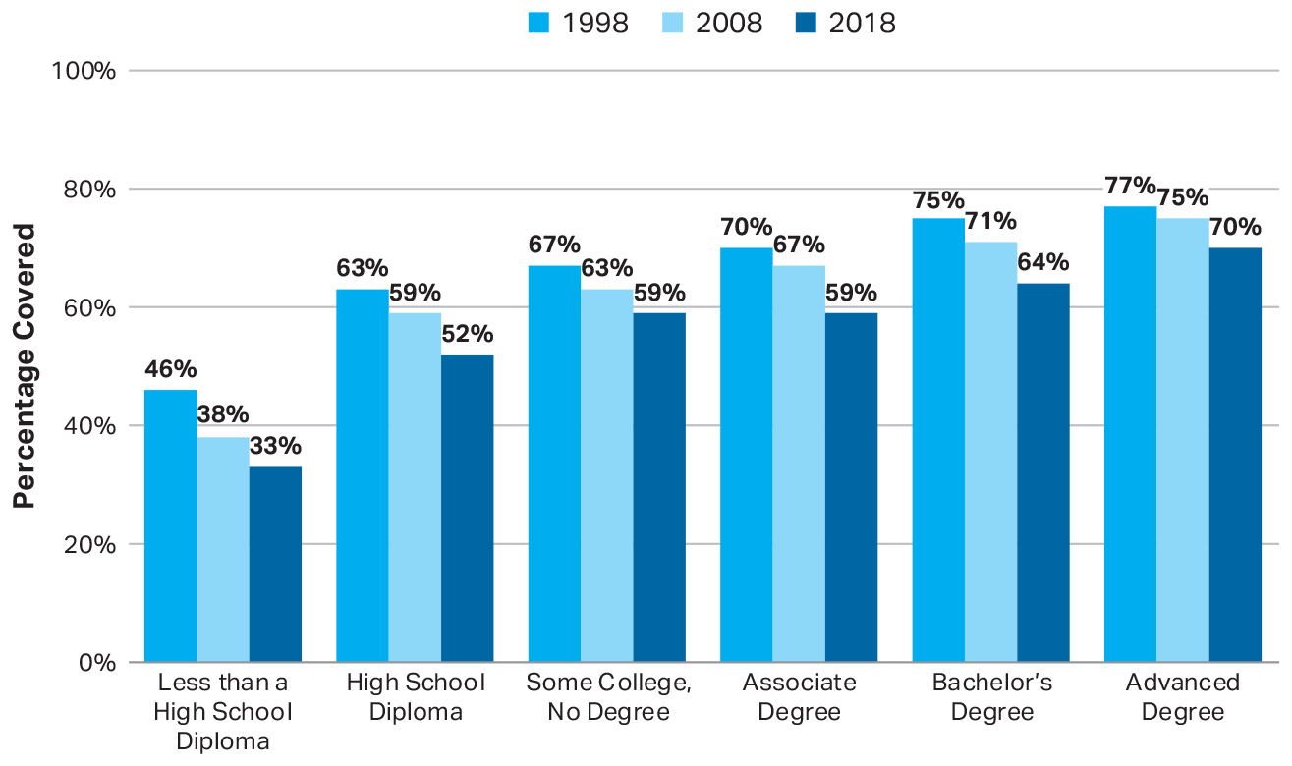
Employer-Provided Health Insurance Coverage Among Full-Time Year-Round Workers Age 25 and Older, by Education Level, 1998, 2008, and 2018
SOURCE: The College Board, Education Pays 2019, Figure 2.14A

Slide 33
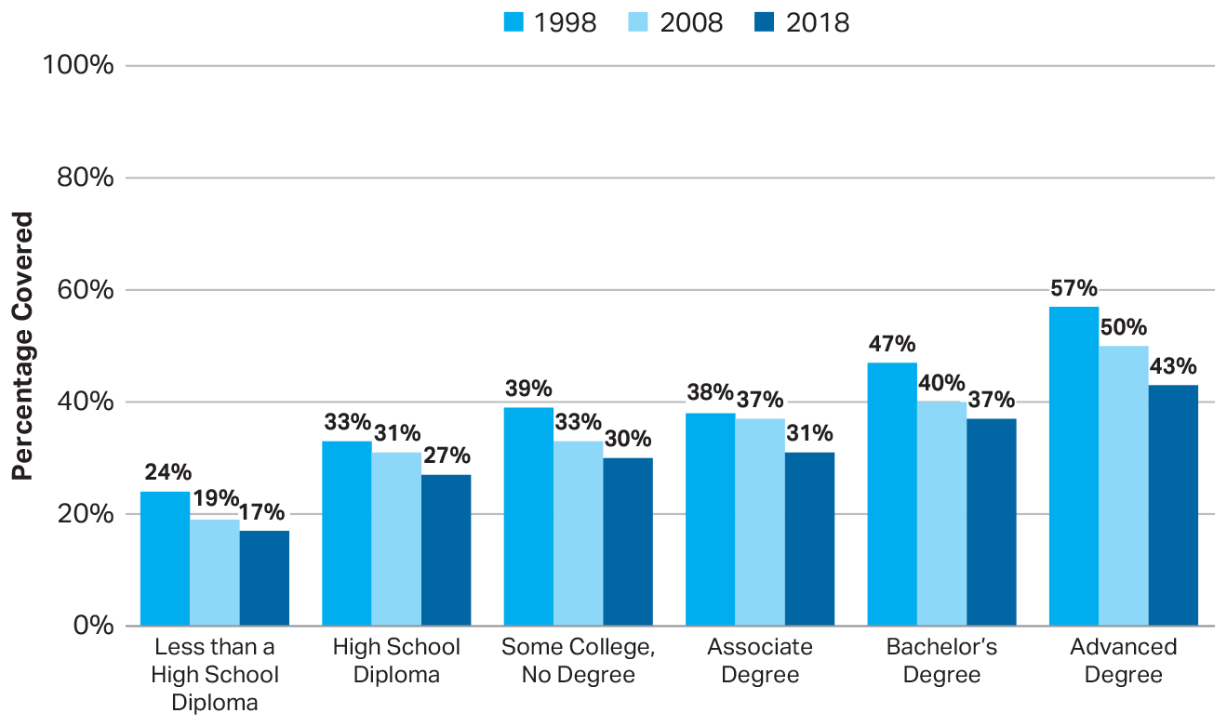
Employer-Provided Health Insurance Coverage Among Part-Time Workers Age 25 and Older, by Education Level, 1998, 2008, and 2018
SOURCE: The College Board, Education Pays 2019, Figure 2.14B

Slide 34
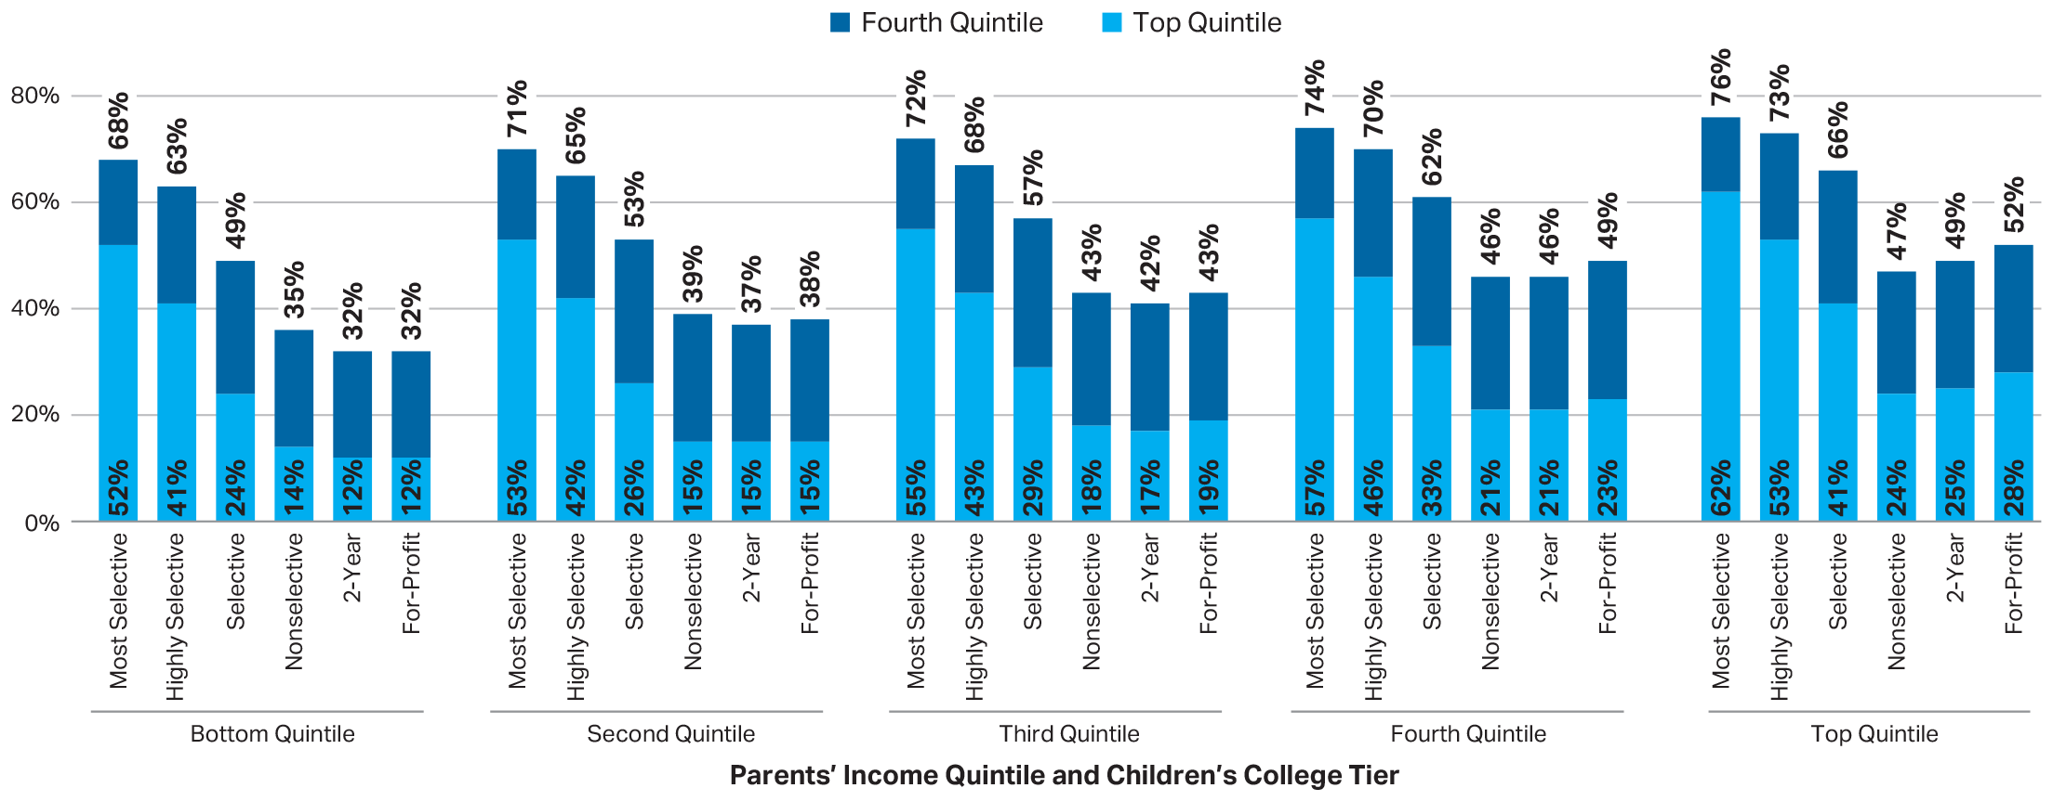
Percentage of Children in Top Two Income Quintiles as Adults, by Parents’ Income Quintile and Children’s College Tier: Children Born in 1980 to 1982
SOURCE: The College Board, Education Pays 2019, Figure 2.15

Slide 35
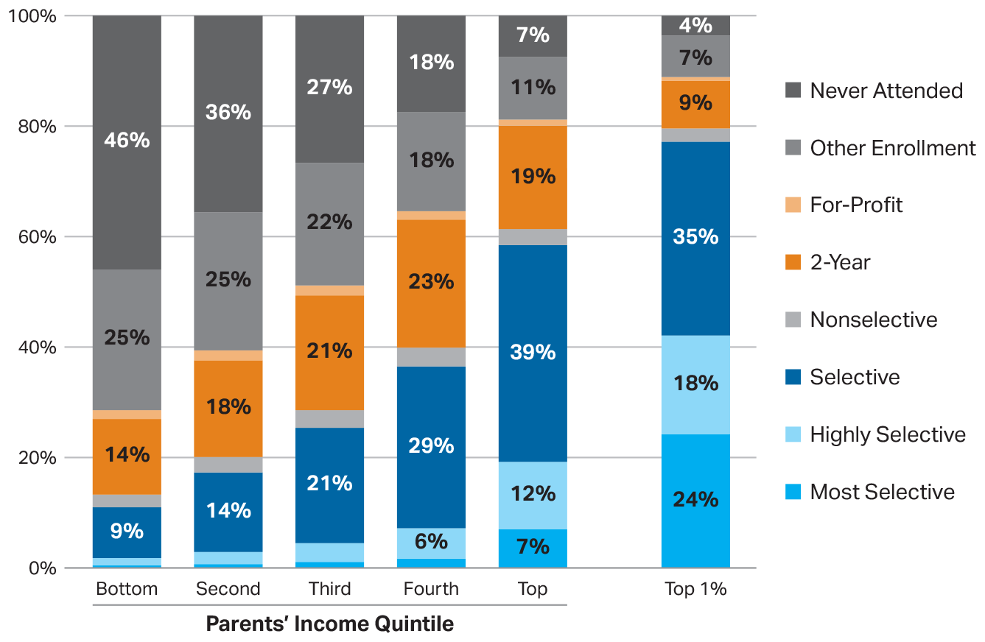
Distribution of College Enrollment by Parents’ Income Quintile, Children Born in 1980 to 1982
SOURCE: The College Board, Education Pays 2019, Figure 2.15

Slide 36
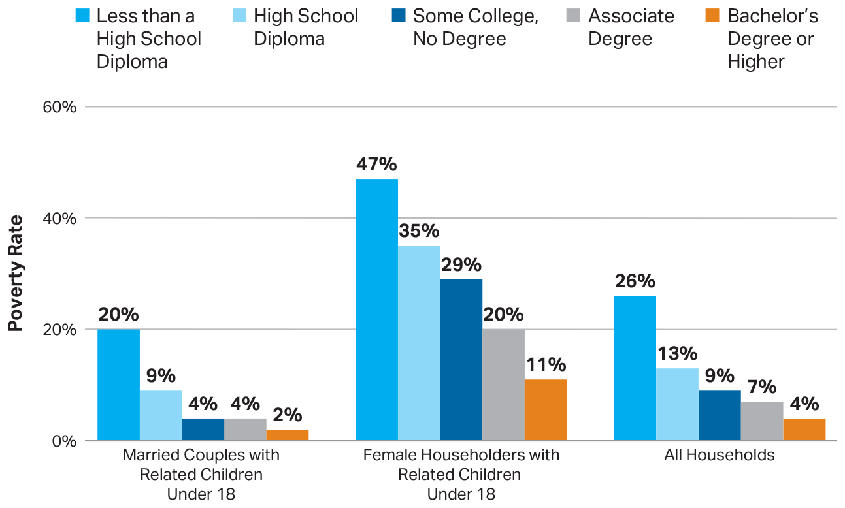
Percentage of Individuals Age 25 and Older Living in Households in Poverty, by Household Type and Education Level, 2018
SOURCE: The College Board, Education Pays 2019, Figure 2.16A

Slide 37
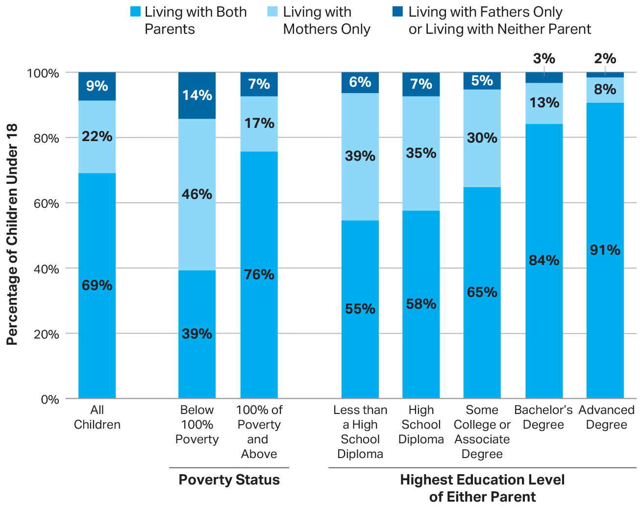
Living Arrangements of Children Under 18, by Poverty Status and Highest Education of Either Parent, 2018
SOURCE: The College Board, Education Pays 2019, Figure 2.16B

Slide 38
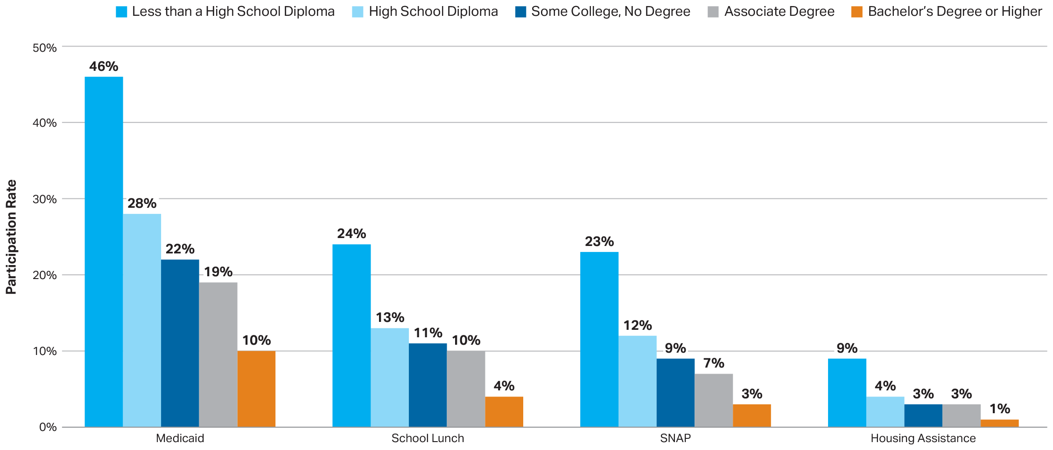
Percentage of Individuals Age 25 and Older Living in Households that Participated in Various Public Assistance Programs, by Education Level, 2018
SOURCE: The College Board, Education Pays 2019, Figure 2.17

Slide 39
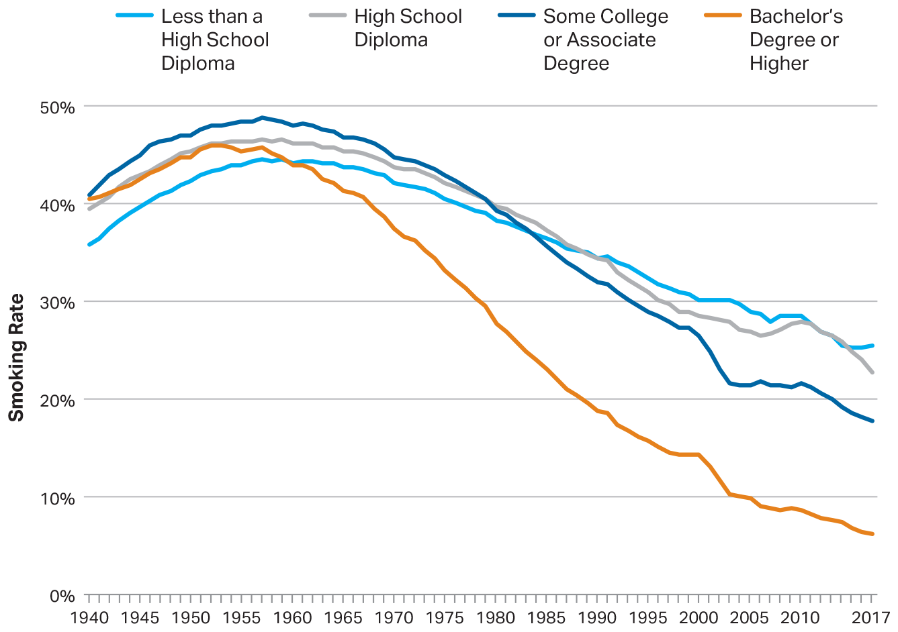
Smoking Rates Among Individuals Age 25 and Older, by Education Level, 1940 to 2017
SOURCE: The College Board, Education Pays 2019, Figure 2.18A

Slide 40
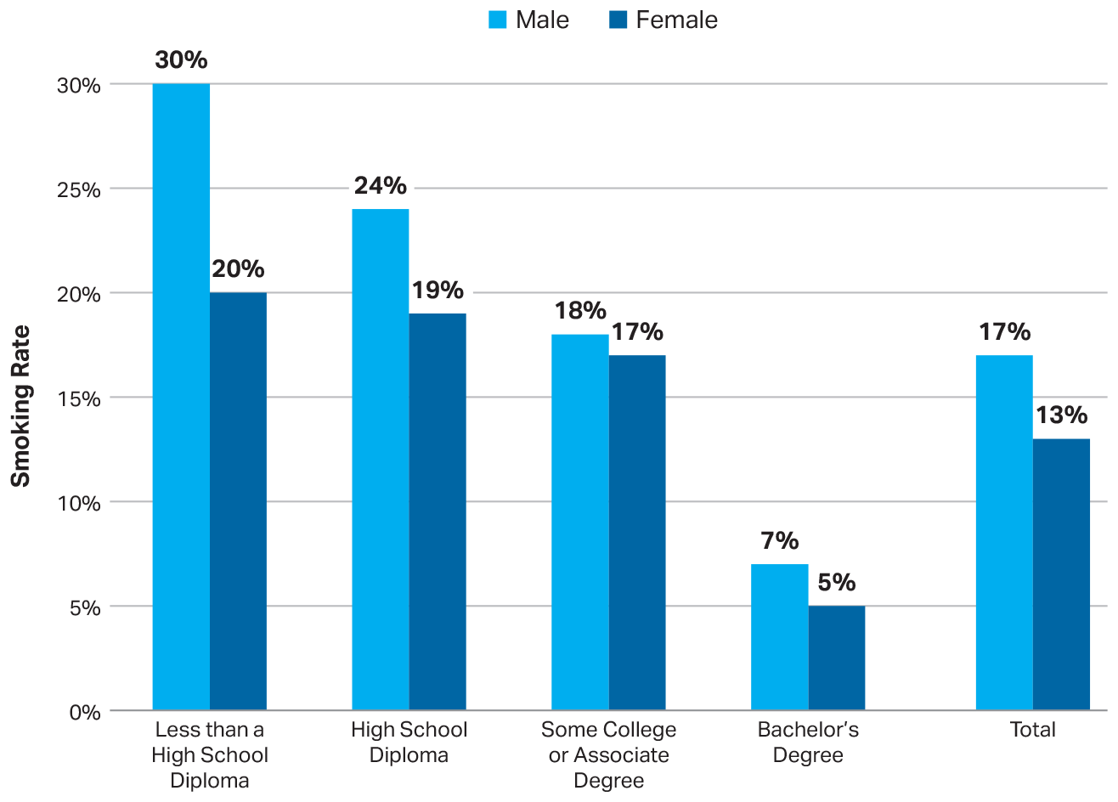
Smoking Rates Among Individuals Age 25 and Older, by Gender and Education Level, 2017
SOURCE: The College Board, Education Pays 2019, Figure 2.18B

Slide 41
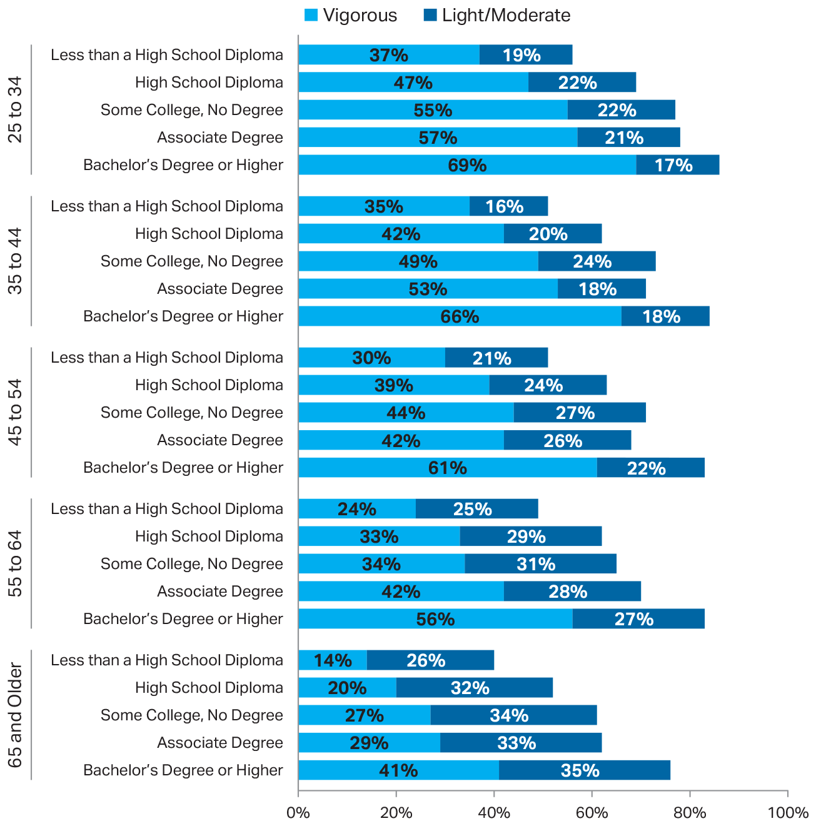
Exercise Rates Among Individuals Age 25 and Older, by Age and Education Level, 2018
SOURCE: The College Board, Education Pays 2019, Figure 2.19A

Slide 42
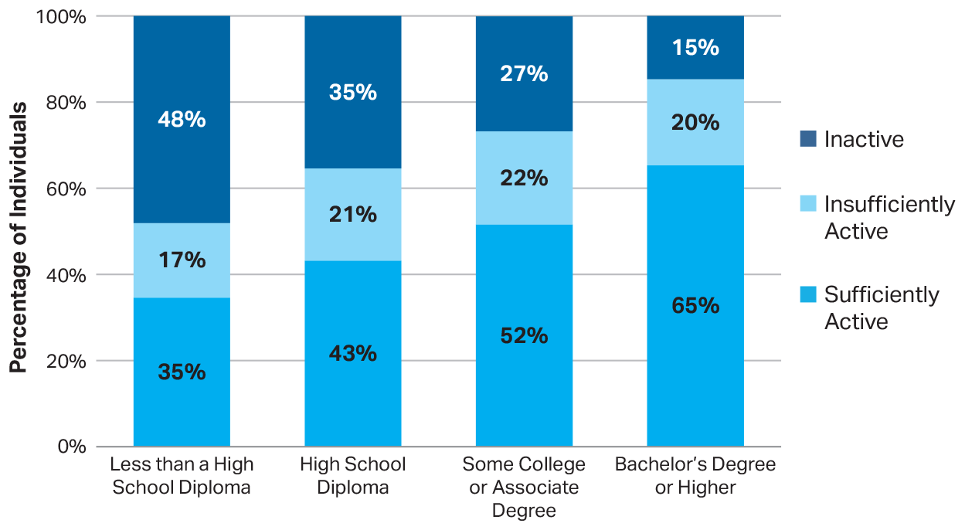
Percentage Distribution of Leisure-Time Aerobic Activity Levels Among Individuals Age 25 and Older, by Education Level, 2018
SOURCE: The College Board, Education Pays 2019, Figure 2.19B

Slide 43
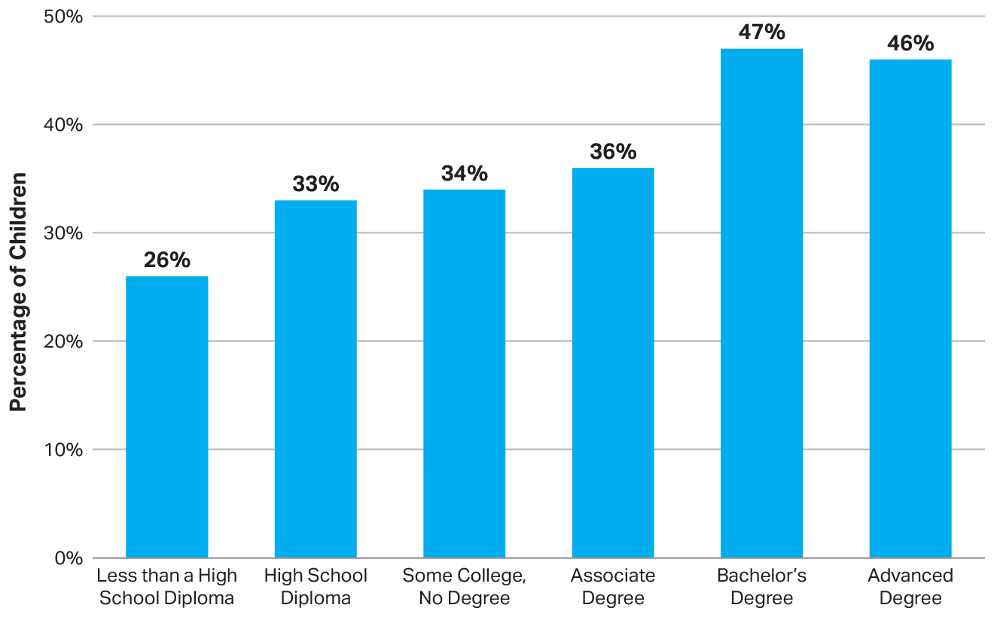
Percentage of 3- to 5-Year-Olds Enrolled in Preschool Programs, by Parents’ Education Level, 2017
SOURCE: The College Board, Education Pays 2019, Figure 2.21A

Slide 44
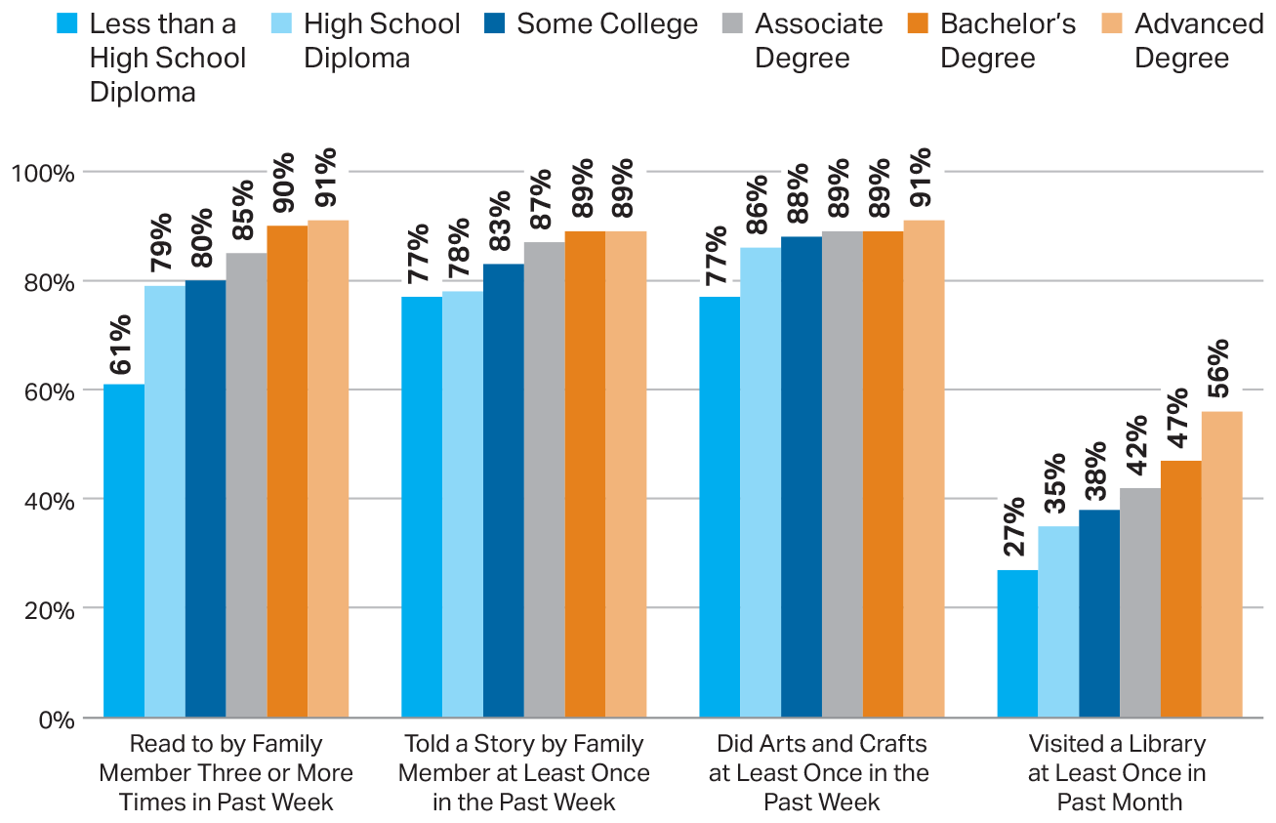
Percentage of 3- to 5-Year-Olds Participating in Activities with a Family Member, by Parents’ Education Level, 2016
SOURCE: The College Board, Education Pays 2019, Figure 2.21A

Slide 45
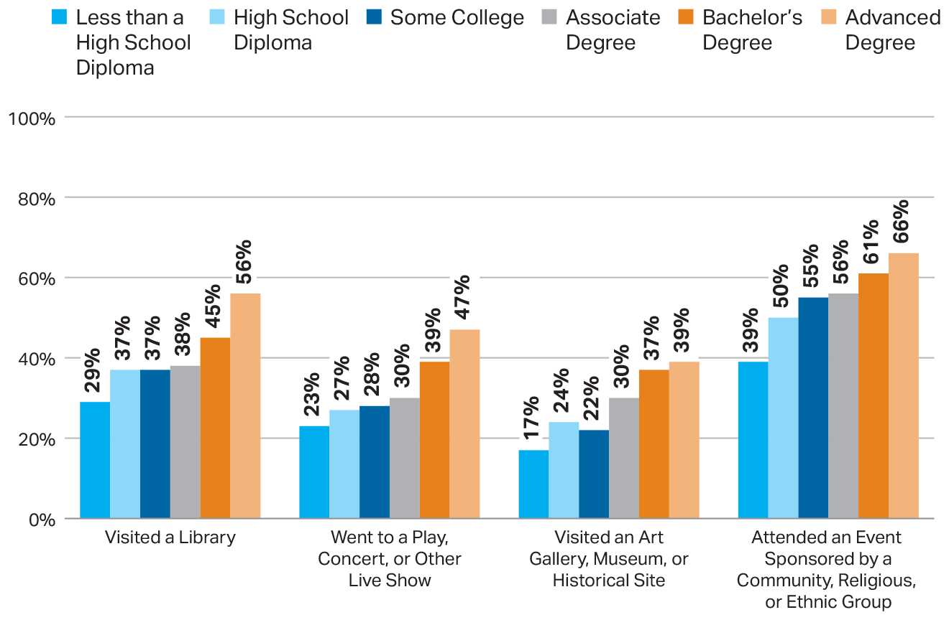
Percentage of Kindergartners Through Fifth-Graders Participating in Activities with a Family Member in the Past Month, by Parents’ Education Level, 2016
SOURCE: The College Board, Education Pays 2019, Figure 2.21B

Slide 46
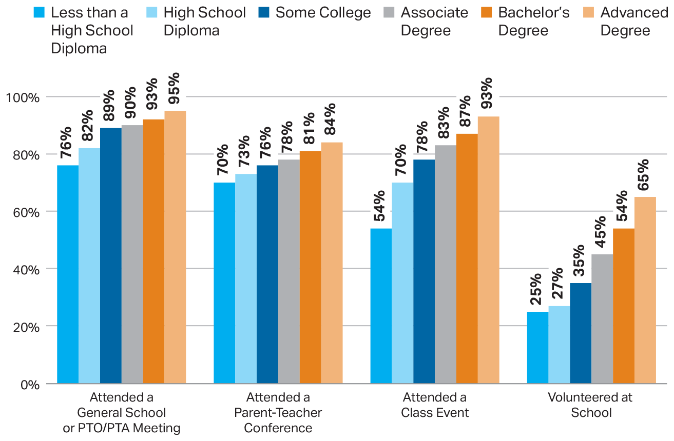
Percentage of Elementary and Secondary School Children Whose Parents Were Involved in School Activities, by Parents’ Education Level, 2016
SOURCE: The College Board, Education Pays 2019, Figure 2.21B

Slide 47
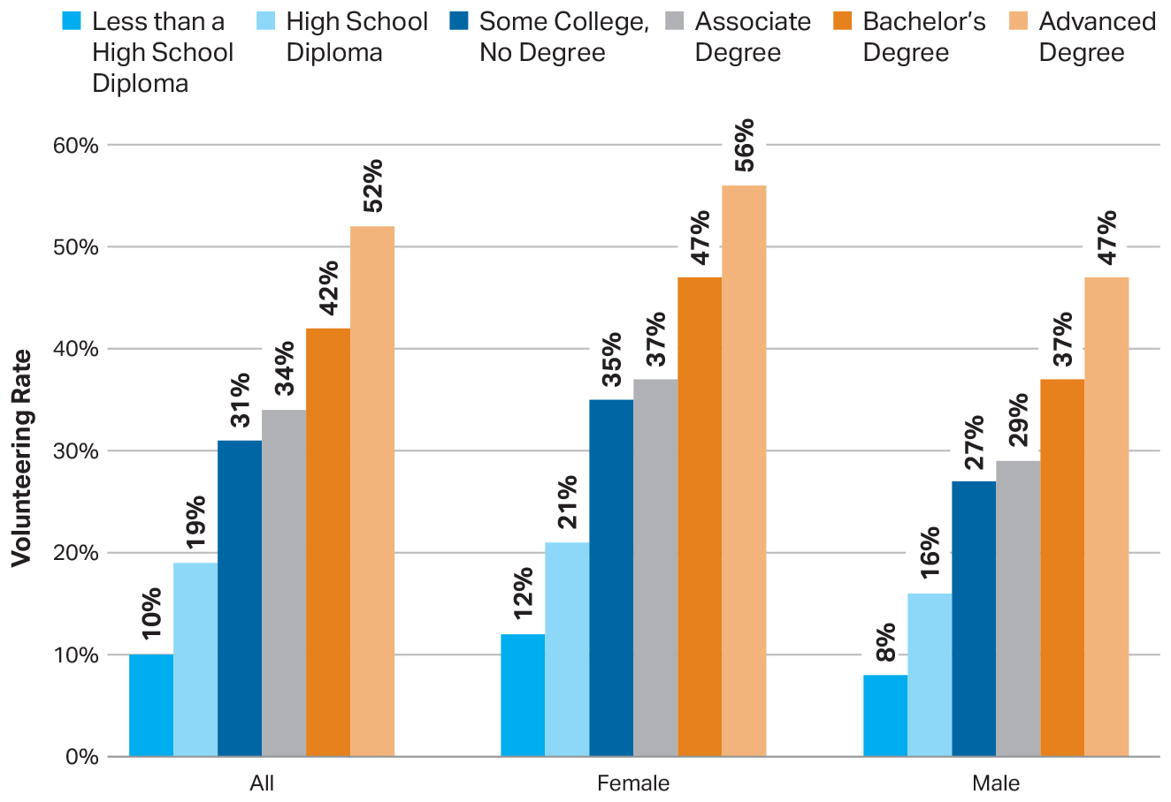
Percentage of Individuals Age 25 and Older Who Volunteered, by Gender and Education Level, 2018
SOURCE: The College Board, Education Pays 2019, Figure 2.22A

Slide 48
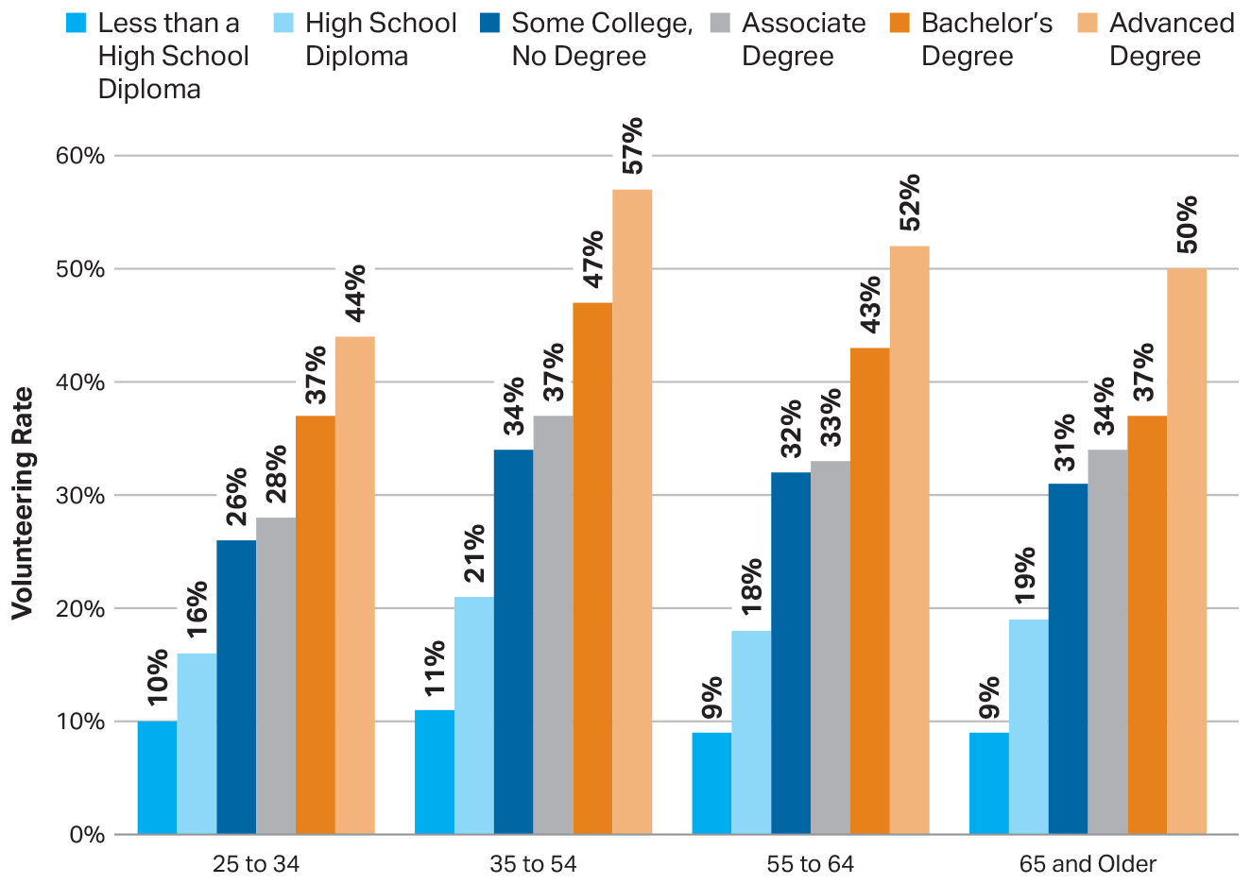
Percentage of Individuals Age 25 and Older Who Volunteered, by Age and Education Level, 2018
SOURCE: The College Board, Education Pays 2019, Figure 2.22B

Slide 49
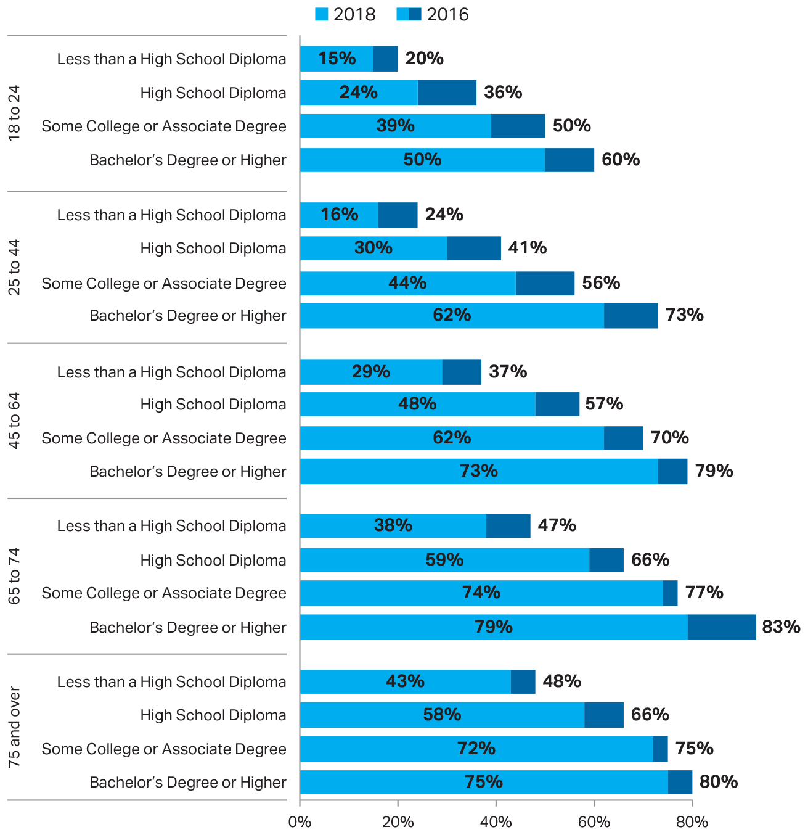
Voting Rates Among U.S. Citizens, by Age and Education Level, 2016 and 2018
SOURCE: The College Board, Education Pays 2019, Figure 2.23A

Slide 50
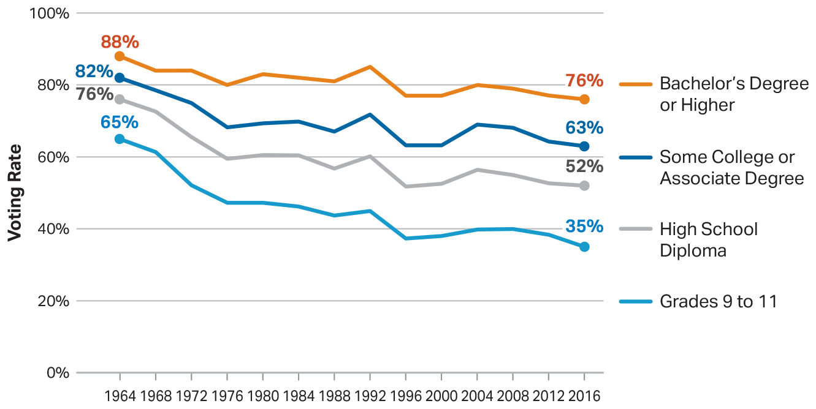
Voting Rates Among U.S. Citizens During Presidential Elections, by Education Level, 1964 to 2016
SOURCE: The College Board, Education Pays 2019, Figure 2.23B

Slide 51
For more information, visit: research.collegeboard.org/trends trends@collegeboard.org

